Slide 1
June 2019

Slide 2
The Global leader in charity, accountability and compassion.
A channel for the expression of His love.

Slide 3
Help To The Helpless
Hope For The Hopeless
Food For The Hungry
Strength For The Weak

Slide 4
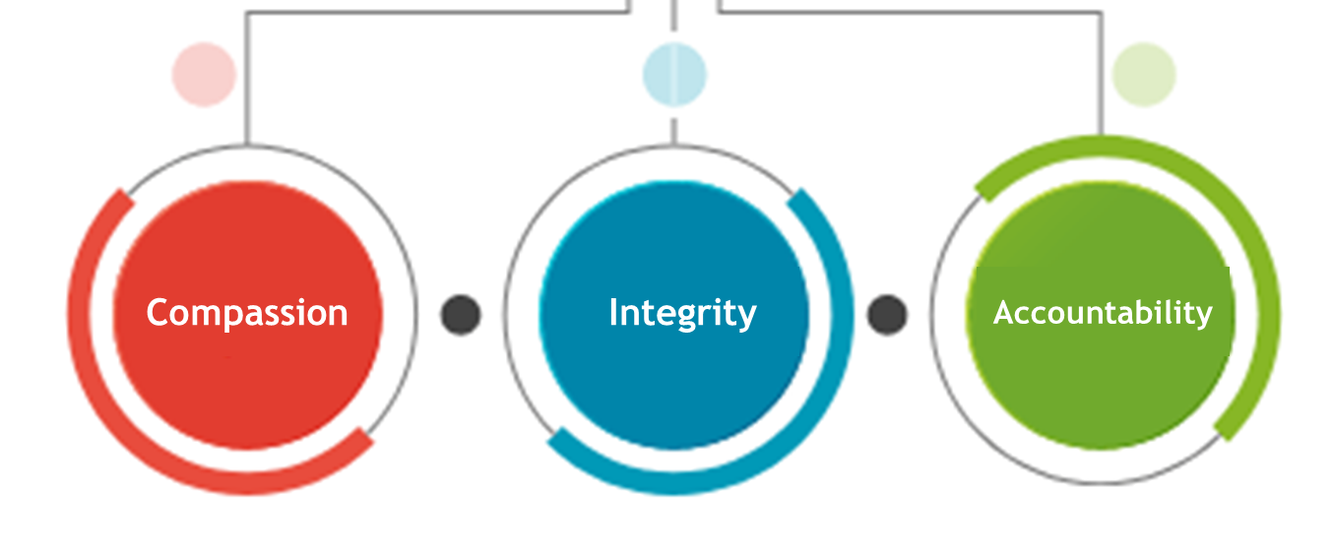

Slide 5
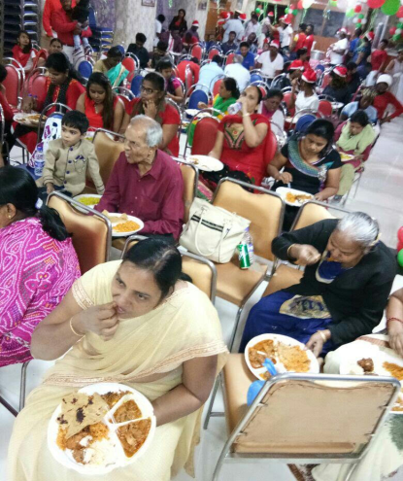
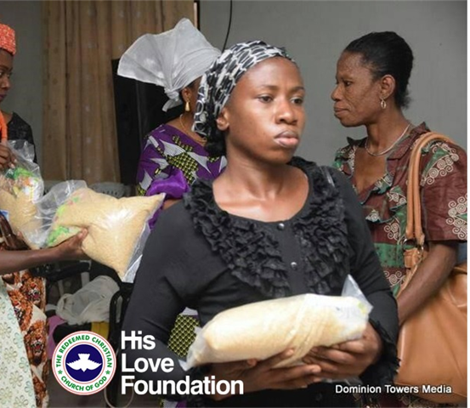
STRATEGIC INTENT
His Love Foundation is a Faith inspired organization serving millions of people worldwide regardless of their sex, religion, social or economic backgrounds.

Slide 6
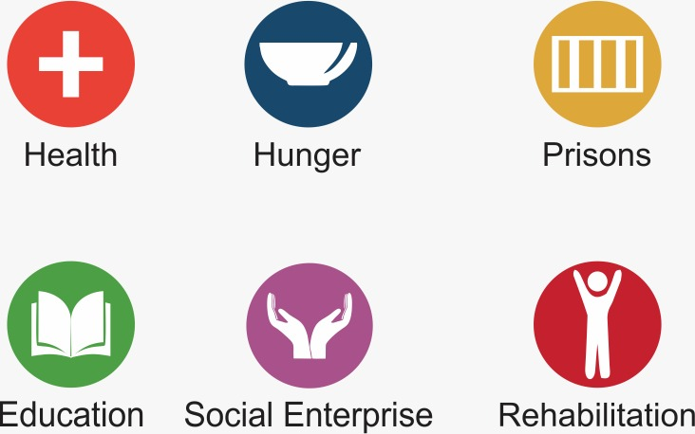

Slide 7
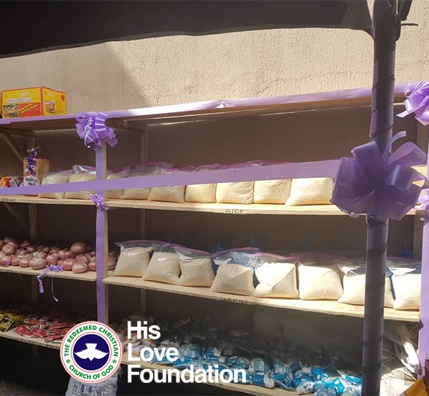
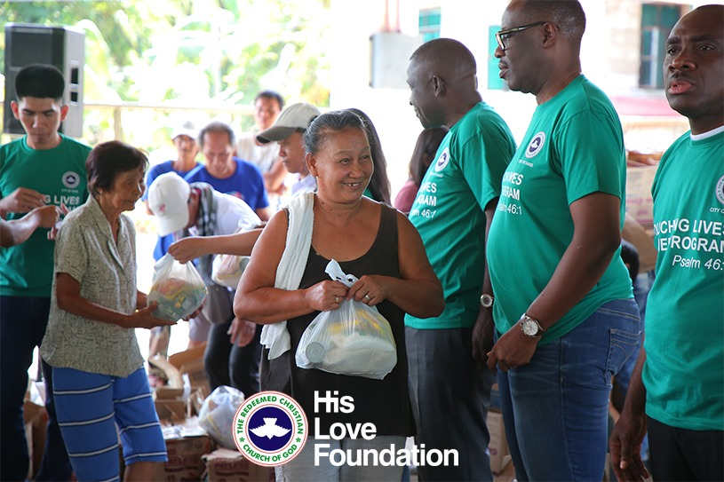
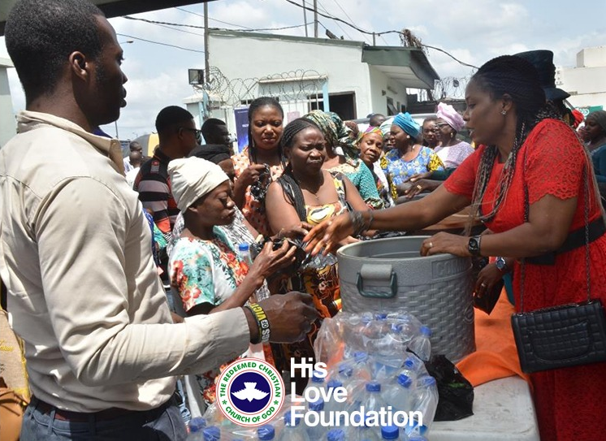
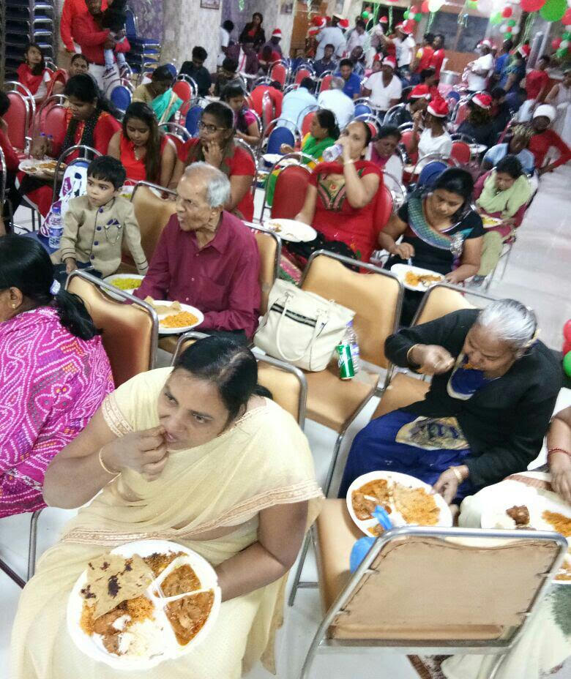
PROJECT OVERVIEW
His Love Foundation has implemented over 70,394 projects in 487 Local Government Areas spread across the 36 States and the Federal Capital Territory of Nigeria between March 2018 – June 2019.

Slide 8
60,902,393
beneficiaries as of June, 2019
36 STATES + FCT
487 LGAs

Slide 9
We collaborate with over 43,599 Partner Center locations all over Nigeria and has operational presence in 197 nations of the world.

Slide 10
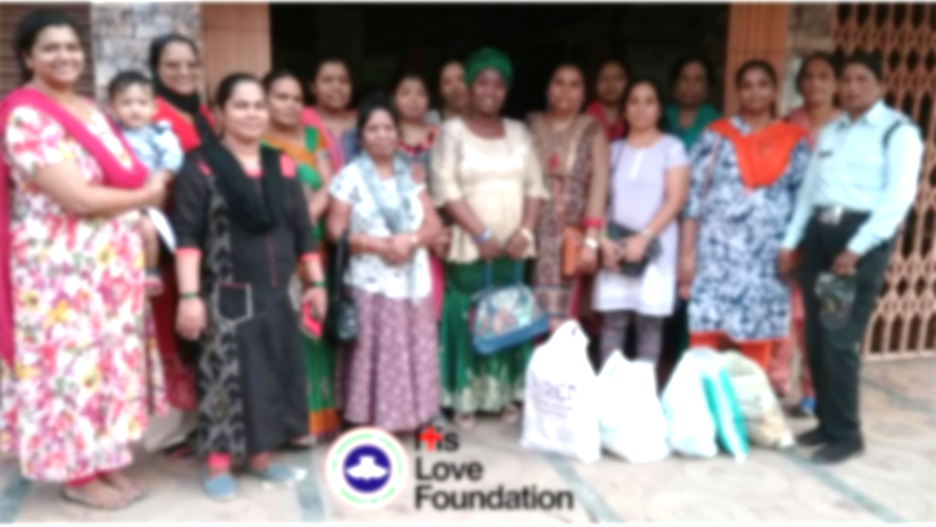
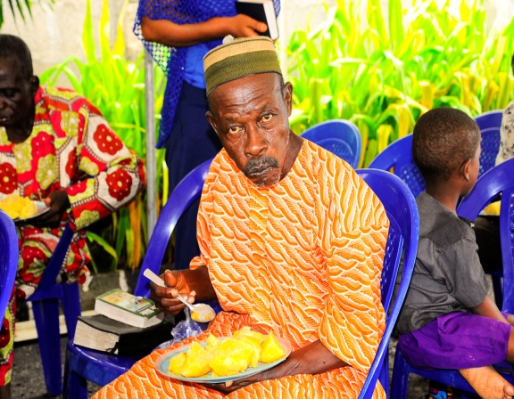
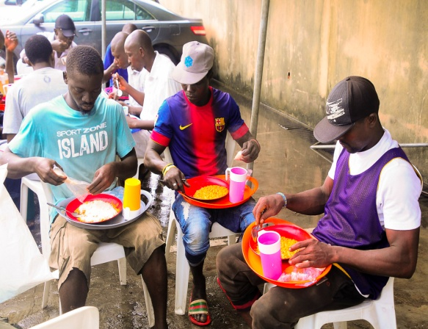
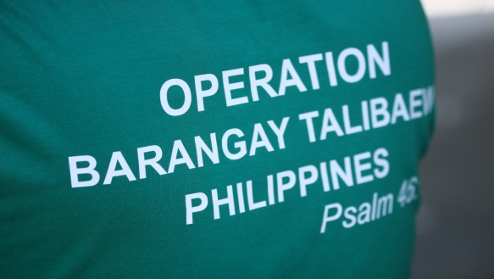
256,839 meals served in daily feeding centres
16 Daily Feeding Centres in Lagos State
43,509 Sunday Feeding Centres in Nigeria
Distribution of food stuffs to 1,000 victims of Super Typhoon at Calasiao Panagasinan, Philippines.
Sunday feeding in all the centres of the 197 nations where RCCG operates
61,206,471
meals served as of July 2019

Slide 11
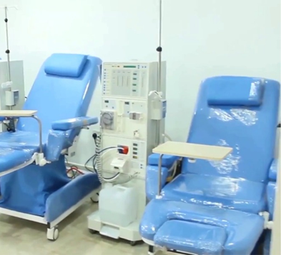
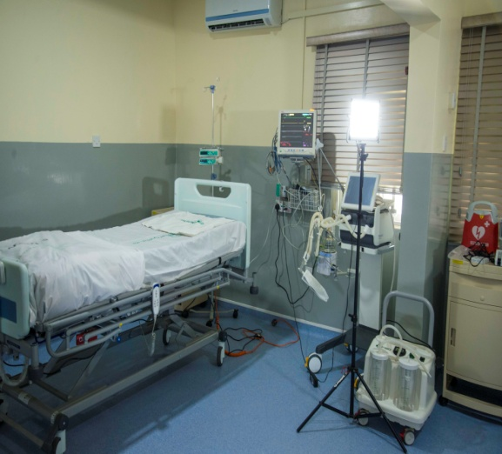
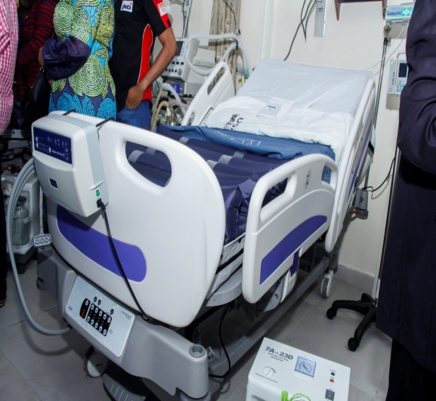
2 Intensive Care Units:
Lagos State University Teaching Hospital (LASUTH)
Plateau State Specialist Hospital, Jos.
222 beneficiaries from Enoch and Folu Adeboye Intensive Care Unit, set up at the Lagos State University Teaching Hospital (LASUTH), Ikeja.
101,837 people have been screened in partnership with Healing Stripes Cancer Screening and Diagnostic Centre Surulere Lagos and Mobile Screening Centres.
9,505 completed dialysis sessions conducted at the Healing Stripes Dialysis Centre. (Every dialysis session is highly subsidized, with a good number done for free).
252,580
beneficiaries of free healthcare services
across Nigeria

Slide 12
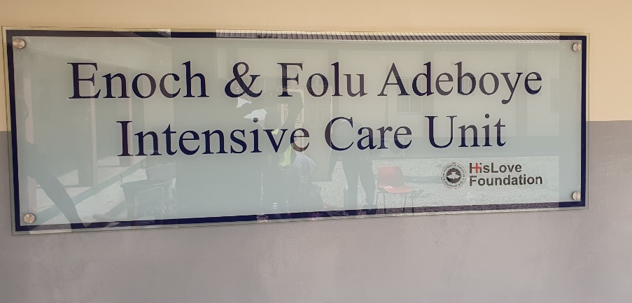
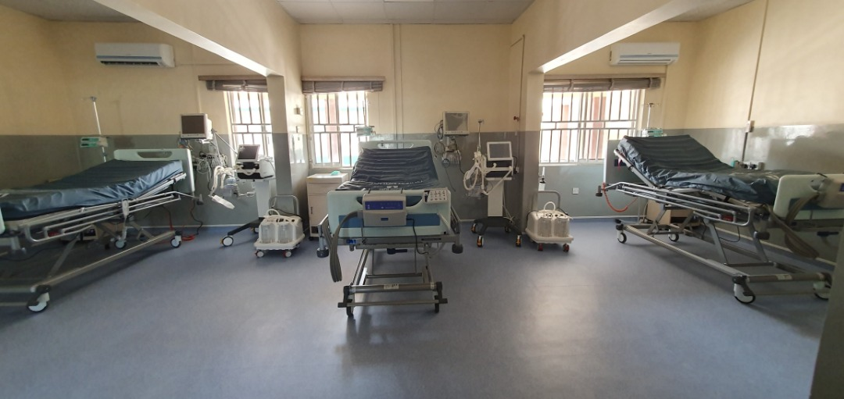
9 successful kidney transplant in partnership with medical institutions abroad .
Favour Maternity and Day-care Center, Delta State.
Donation of Hospital Equipment to Gbagada General Hospital.
Redeemer's Maternity Centre Ito-Omu to provide free medical services to the indigent pregnant women in the community.
252,580
beneficiaries of free healthcare services
across Nigeria

Slide 13
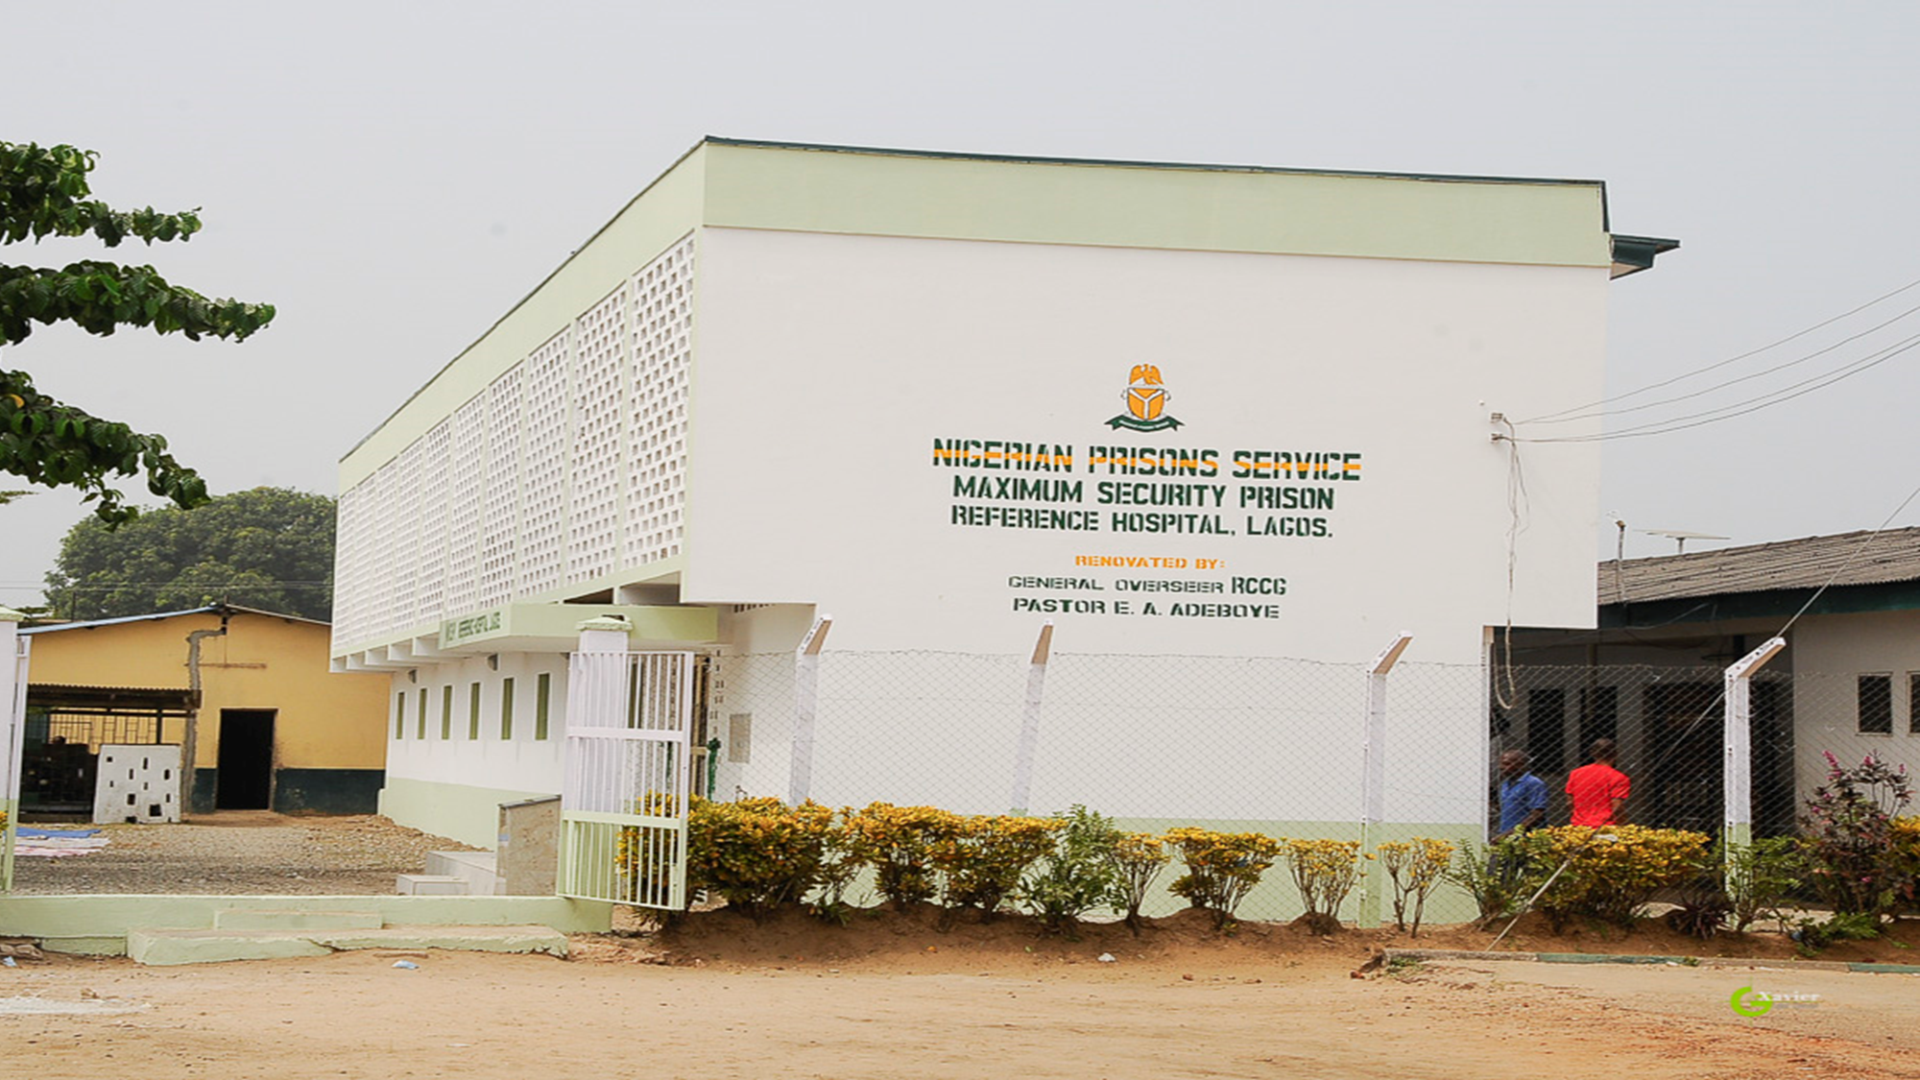
98,767
inmates have so far benefited
Refurbishing and equipping of the Kirikiri Maximum Prison Reference Hospital Lagos.
Donation of Ambulances to Kirikiri Maximum Prison and Agodi Prison Ibadan.
Donation of generators to both Kirikiri and Ikoyi Maximum Prisons.

Slide 14
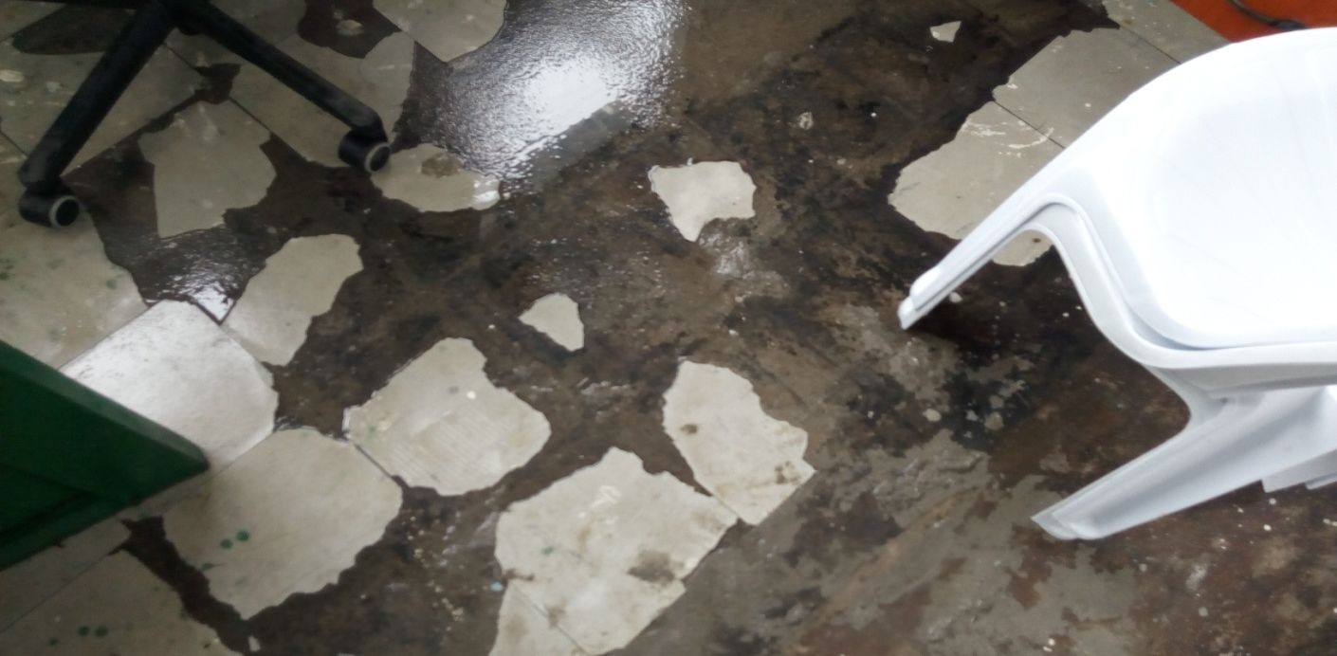
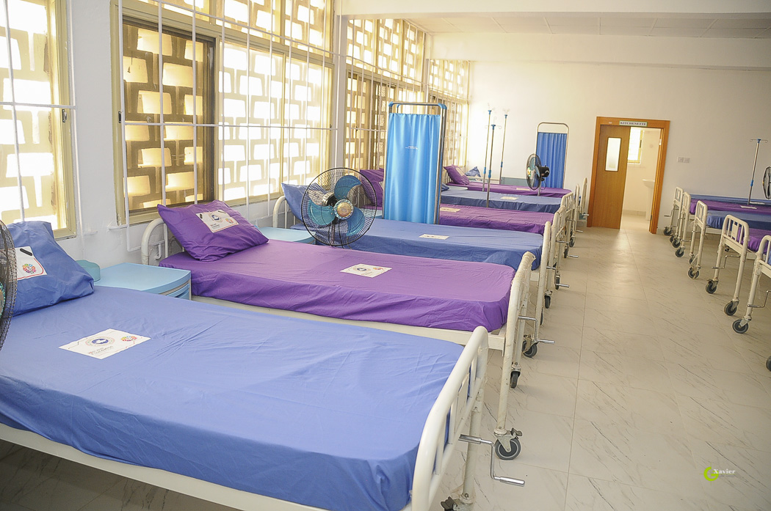
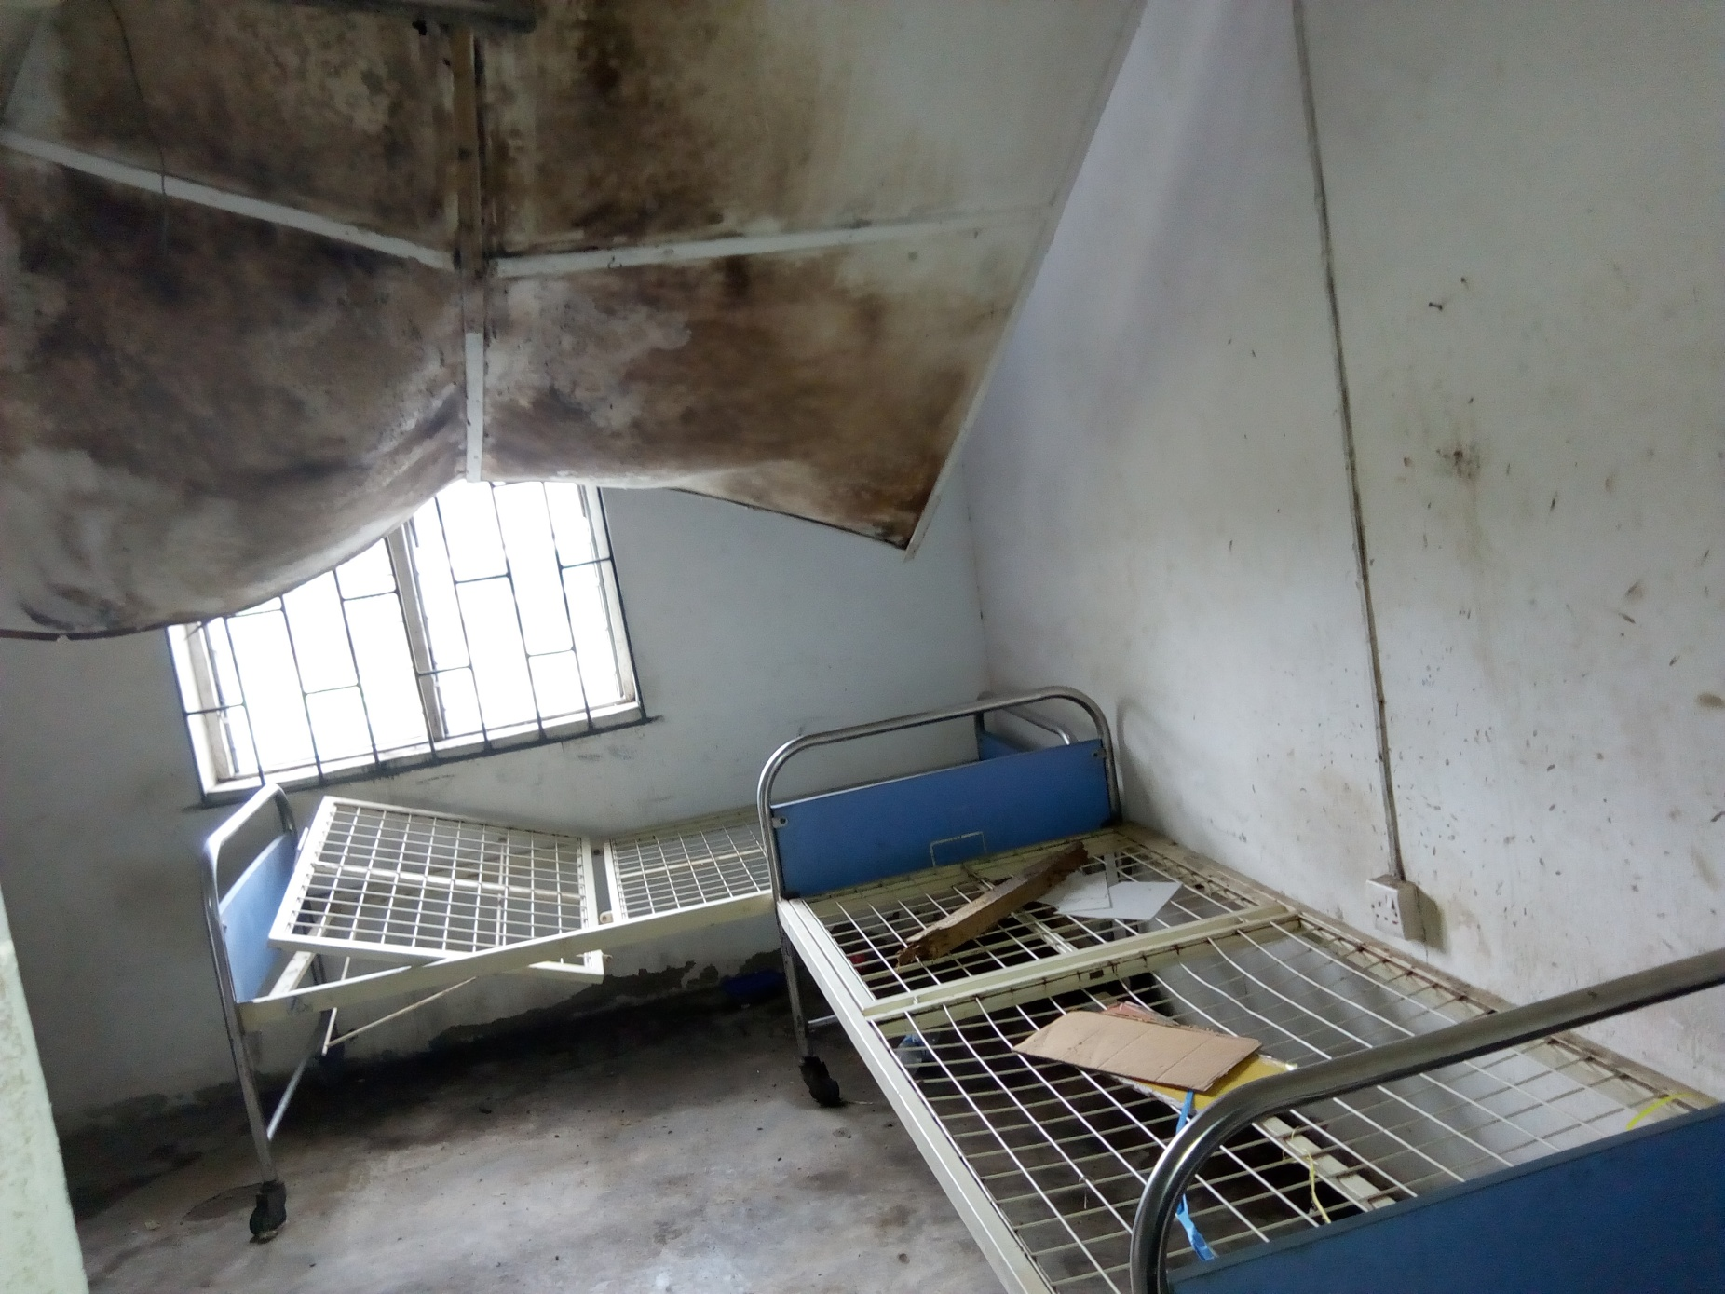
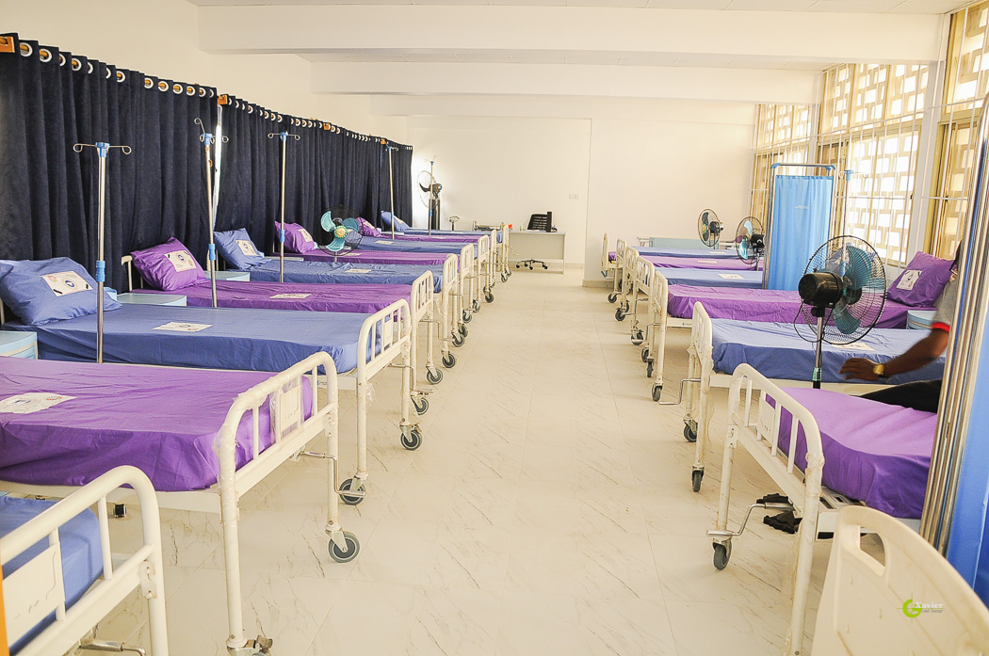
Kirikiri Maximum Prison Reference Hospital Lagos
Before
After
After
Before

Slide 15
Refurbishing of the meeting hall at Kirikiri Maximum Prison
Enrolment of prison inmates for GCE/O’Levels
Installation of over 40 solar powered streets lights for the Kirikiri community
Renovation of Liberty Chapel Building at Kirikiri
Donation and Equipping of the Kirikiri Prison ICT Center /Computer Laboratory.
Provision of Foodstuffs from our food bank.

Slide 16
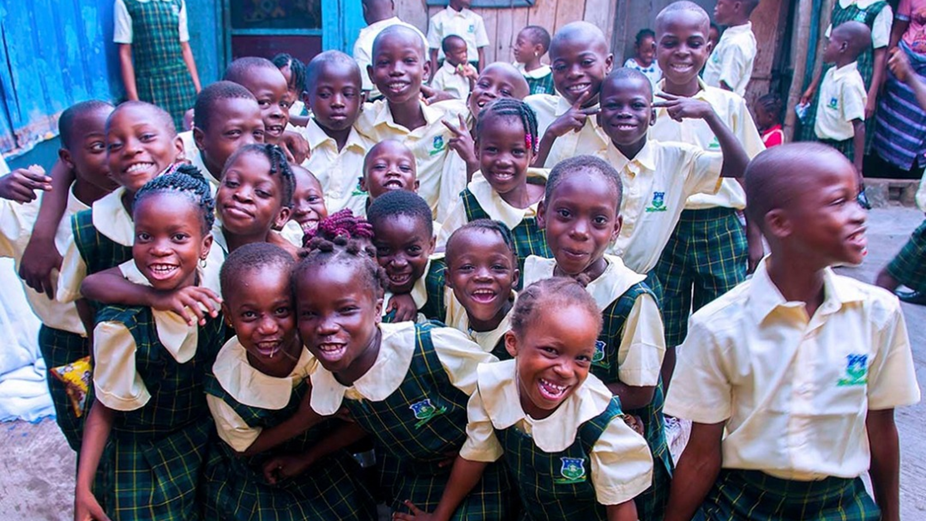
7 Free education schools (Free Tuition, Free Uniforms, Free Meals, Free Books)
Redeemer’s Fortress School Umu-Obi Awkuzu, Anambra-State
Hope Center Makoko, Lagos State.
The Redeemer’s Nursery and Primary School, Oko Abe
The Redeemer’s Junior Secondary School Ito-Omu
The Redeemer’s Senior Secondary School Ito-Omu
Liberty School provides free Education for the people of Maryland and Ajah Communities.
Redeemer’s Glorious Seed Academy, Okuta-Elerinla
125 primary schools in Lagos State equipped with library books
96,622
Student scholarships granted

Slide 17
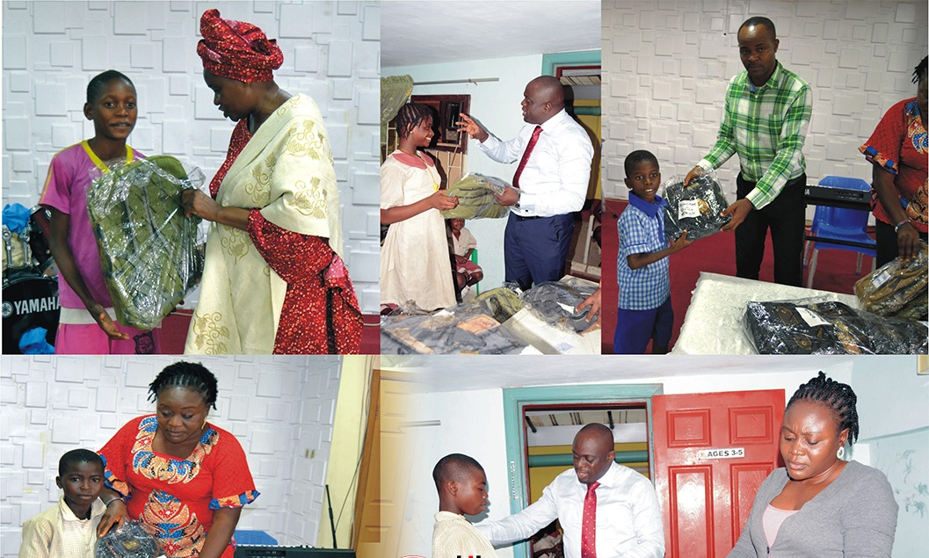
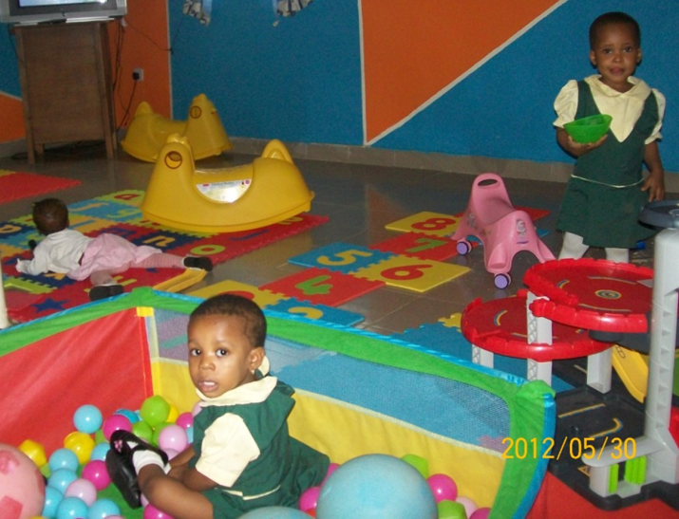
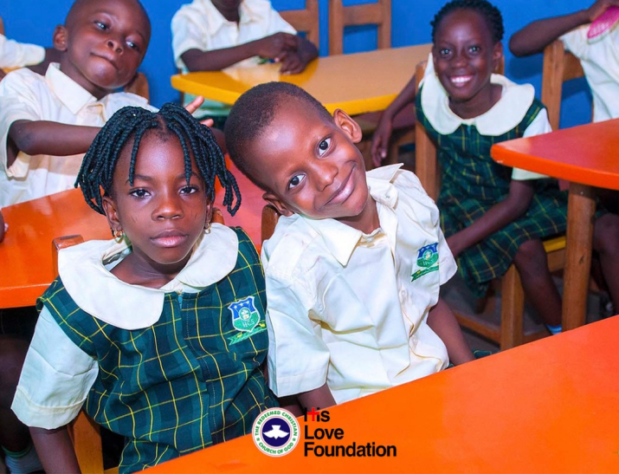
Scholarships and grants to over 100,613 students
Renovation of Omole High School Ojodu
Adopt a school Project
Model Nursery and Primary Maruwa Lekki Phase 1.
Scholarship Awards:
Wisdom Group Scholarship Program – for 56 Beneficiaries.
ENOCH ADEJARE ADEBOYE ANNUAL MATHEMETICS COMPETITION (EAAMC) for Secondary Schools in Lagos
5 Enoch Adeboye Professorial Chair in Mathematics totalling 250 million naira:
Obafemi Awolowo University, Ile-ife, Osun State
University of Ibadan, Oyo State
University of Jos, Plateau State
University of Lagos , Akoka, Lagos State
University of Nigeria Nsukka, Enugu State

Slide 18
4,202 It’s New To Me charity shops beneficiaries
3 It's New to Me Charity Shops outlets in Akoka, Oniru and Ikorodu
96,556 students trained from the various RCCG Vocational Institutes nationwide.
290 Business networks beneficiaries in conjunction with the Lagos State Employability Trust Fund (LSETF)
Entrepreneurial Training
The foundation in partnership with training partners is implementing a national training programme to equip over 100,000 beneficiaries with skills in Bead-making, Catering, Digital Skills Certification, Electronics Repairs and Maintenance, Fashion Designing, Photography, Shoe Making, Programme Coding etc.
4,202
It’s New To Me Charity Shops beneficiaries

Slide 19
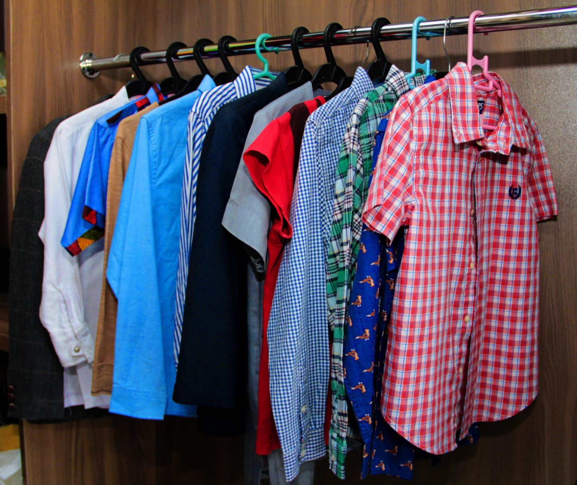
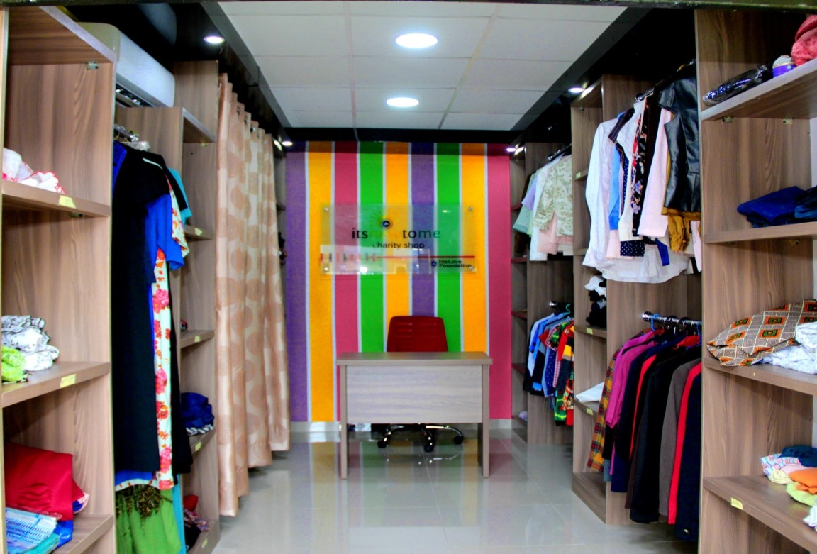
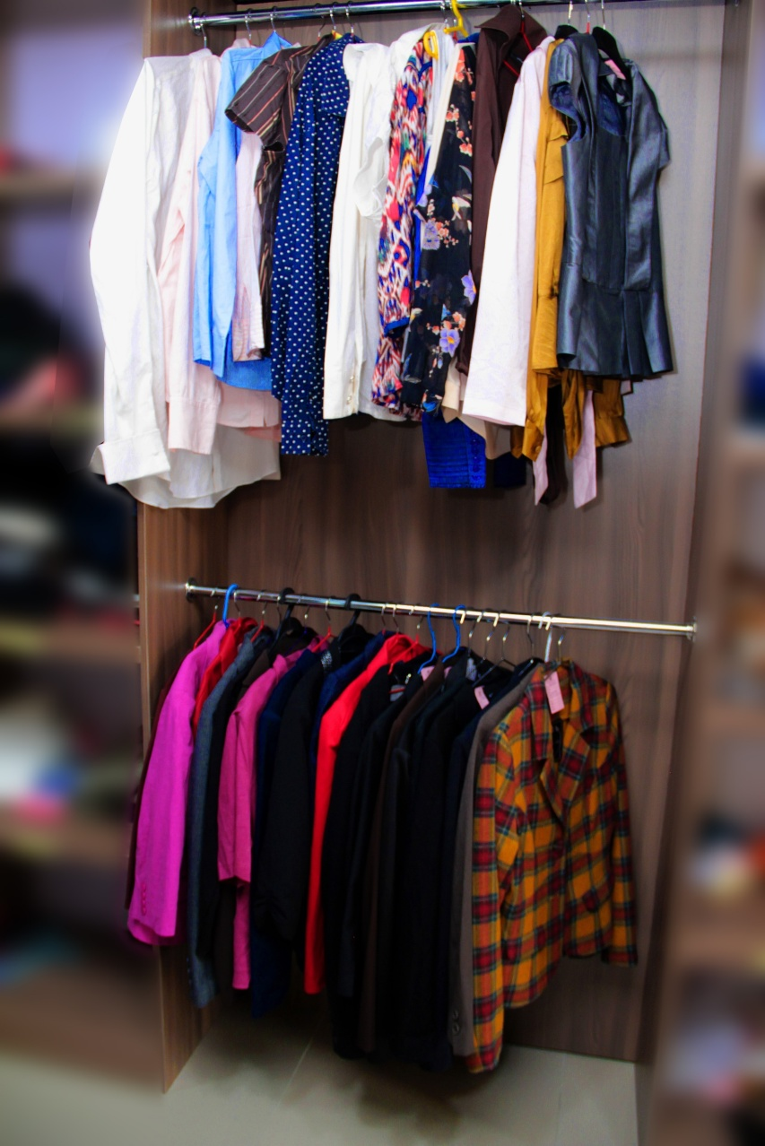
It's New to Me Charity Shops

Slide 20
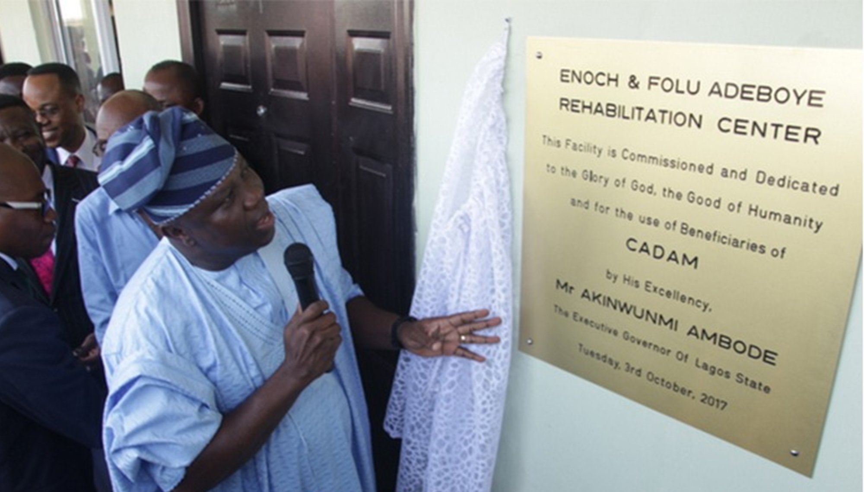
6,976 beneficiaries of Habitation of Hope Rehabilitation Centre
4,000 beneficiaries of Christ Against Drugs Abuse Ministry (CADAM)
1,003 beneficiaries of Wholistic Outreach (Rehabilitation of Prostitutes and Abandoned Girls)
518 beneficiaries of Wellspring Rehabilitation Centre
41 beneficiaries of Virtuous Women (Rehabilitation of Commercial Sex Workers)
12,958
inmates have so far benefited

Slide 21
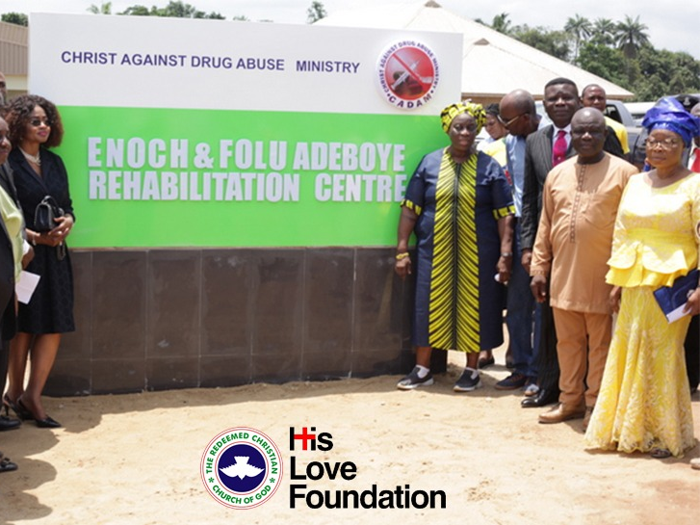
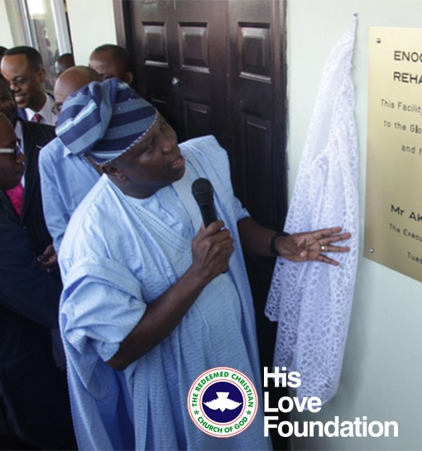

Slide 23
Thank you.

