Slide 1
APICP-CSR CONFERENCE FOR YOUTHS AND YOUNG ADULTS’ PROVINCES

Slide 2
INTRODUCTION
The Office of the Special Assistant to the General Overseer was established in January 2018 to oversee the Christian Social Responsibility function in the mission globally.
The Office of the Intercontinental Overseer Christian Social Responsibility was established in 2021.
#RCCGLoveInAction

Slide 3
PROBLEM STATEMENT
Prior to the establishment of the CSR function, the mission suffered a deluge of criticisms and misgivings in respect of its impact in society (Daddy Freeze).
The presumption then was that the church was focused on the spiritual needs of the people, without attending to their immediate social and physical needs.
This erroneously portrayed the church as only taking from the people without giving back.
There was therefore the need to change this unwholesome narrative by the establishment of the Christian Social Responsibility arm of the mission
#RCCGLoveInAction

Slide 4
PROBLEM STATEMENT As the curtain of the world rolls to an end, there is so much destitution, devastation, disease, despair and despondency. The people are hurting, and we must give them the comfort of Christ in all its ramifications. The Church is losing influence and relevance globally. We have treated CSR with kid gloves because we lack understanding of its importance. Thus, the need to establish Christian Social Responsibility as a core arm of the mission.
#RCCGLoveInAction

Slide 5
The Mandate
4
2
1
3
5
Initiation & Implementation
Coordination
Harmonization
Standardization
Communication

Slide 6
The Mandate 1. Initiation & Implementation – to establish and implement a CSR policy for the mission. 2. Coordination – to maintain oversight and coordinate all CSR programs of all the organs of the mission 3. Harmonization – to harmonize all CSR programs, processes and activities at all levels and arms of the mission for greater impact.
#RCCGLoveInAction

Slide 7
The Mandate 4. Standardization – to establish, guide and ensure compliance with approved standards 5. Communication To provide the framework for internal and external communication and drive the overall CSR communication for the mission.
#RCCGLoveInAction

Slide 8
Role Of CSR Office To position the mission to demonstrate more active CSR presence in society and communities and to be able to effectively communicate its positive contribution via social media, online platforms, public forums and all other media channels.
#RCCGLoveInAction

Slide 9
ROADMAP
1. A think tank was setup comprising professionals in various cadares to strategize and develop the roadmap for the new assignment.
2. Trainings and Workshops were arranged internally and we attended programs at the Canadian High Commission, Lagos Business School and Alder Consulting.
3. We developed the Policy document and the Operational Manual as the framework for Christian Social Responsibility across the mission globally.
#RCCGLoveInAction

Slide 10
ROADMAP
4. The Policy document and the Operational Manual are available on the website [www.hislovefoundation.com]
5. We did a nation-wide training and sensitisation of all APICP CSR in the mission on the new direction for the assignment
6. We setup up ‘HIS LOVE FOUNDATION’- the RCCG Charity as the external arm of our social intervention globally.
#RCCGLoveInAction

Slide 11
What Is Christian Social Responsibility (CSR)? Christian Social Responsibility is a faith-based obligation to meet societal needs through the demonstration of love that positively impacts communities and individuals. #RCCGLoveInAction
#RCCGLoveInAction

Slide 12
Why Christian & Not Corporate Social Responsibility?
CSR has its root in Christianity and the church is meant to be an example for the world to follow and not the other way around
#RCCGLoveInAction

Slide 13
Why Christian & Not Corporate Social Responsibility?
The oldest company (Kongo Gumi Construction) in the world is less than 2000 years – was incorporated 578 AD
The word ‘company’ has its roots in two Latin words ‘Com’ & ‘panies’, which means breaking bread together, thereby showing that the origin of CSR has communal or social connotation which speaks of the way of life of the early Christians (Leviticus 25:35).
#RCCGLoveInAction

Slide 14
Christian Social Responsibility
We pushed this acronym and now it is widely accepted that the appropriate meaning of C.S.R should be ‘Christian Social Responsibility’. This concept has now been utilized both in research, at the doctorate level and in the Consulting sector by Alder Consulting.

Slide 15
The Case For CSR
Heartbeat Of God – CSR is the expression of love, being the heartbeat of God.
The Hurting World - It is about bringing comfort to a hurting world.
Connection To Others - It closes the needs’ gap in the society.
It is the global standard of rating for corporate organisations
#RCCGLoveInAction

Slide 16
Sustainable Development Goals
One of the reasons why this office was created is to harmonize all RCCG programs, processes and activities for greater impact.
We have discovered that out of the 17 global sustainable Goals (Vision 2030) signed by 198 nations including Nigeria, RCCG as a faith-based organization is active in 13 of these.
This fact is unknown therefore affecting the compliance ratio for Nigeria
#RCCGLoveInAction

Slide 17
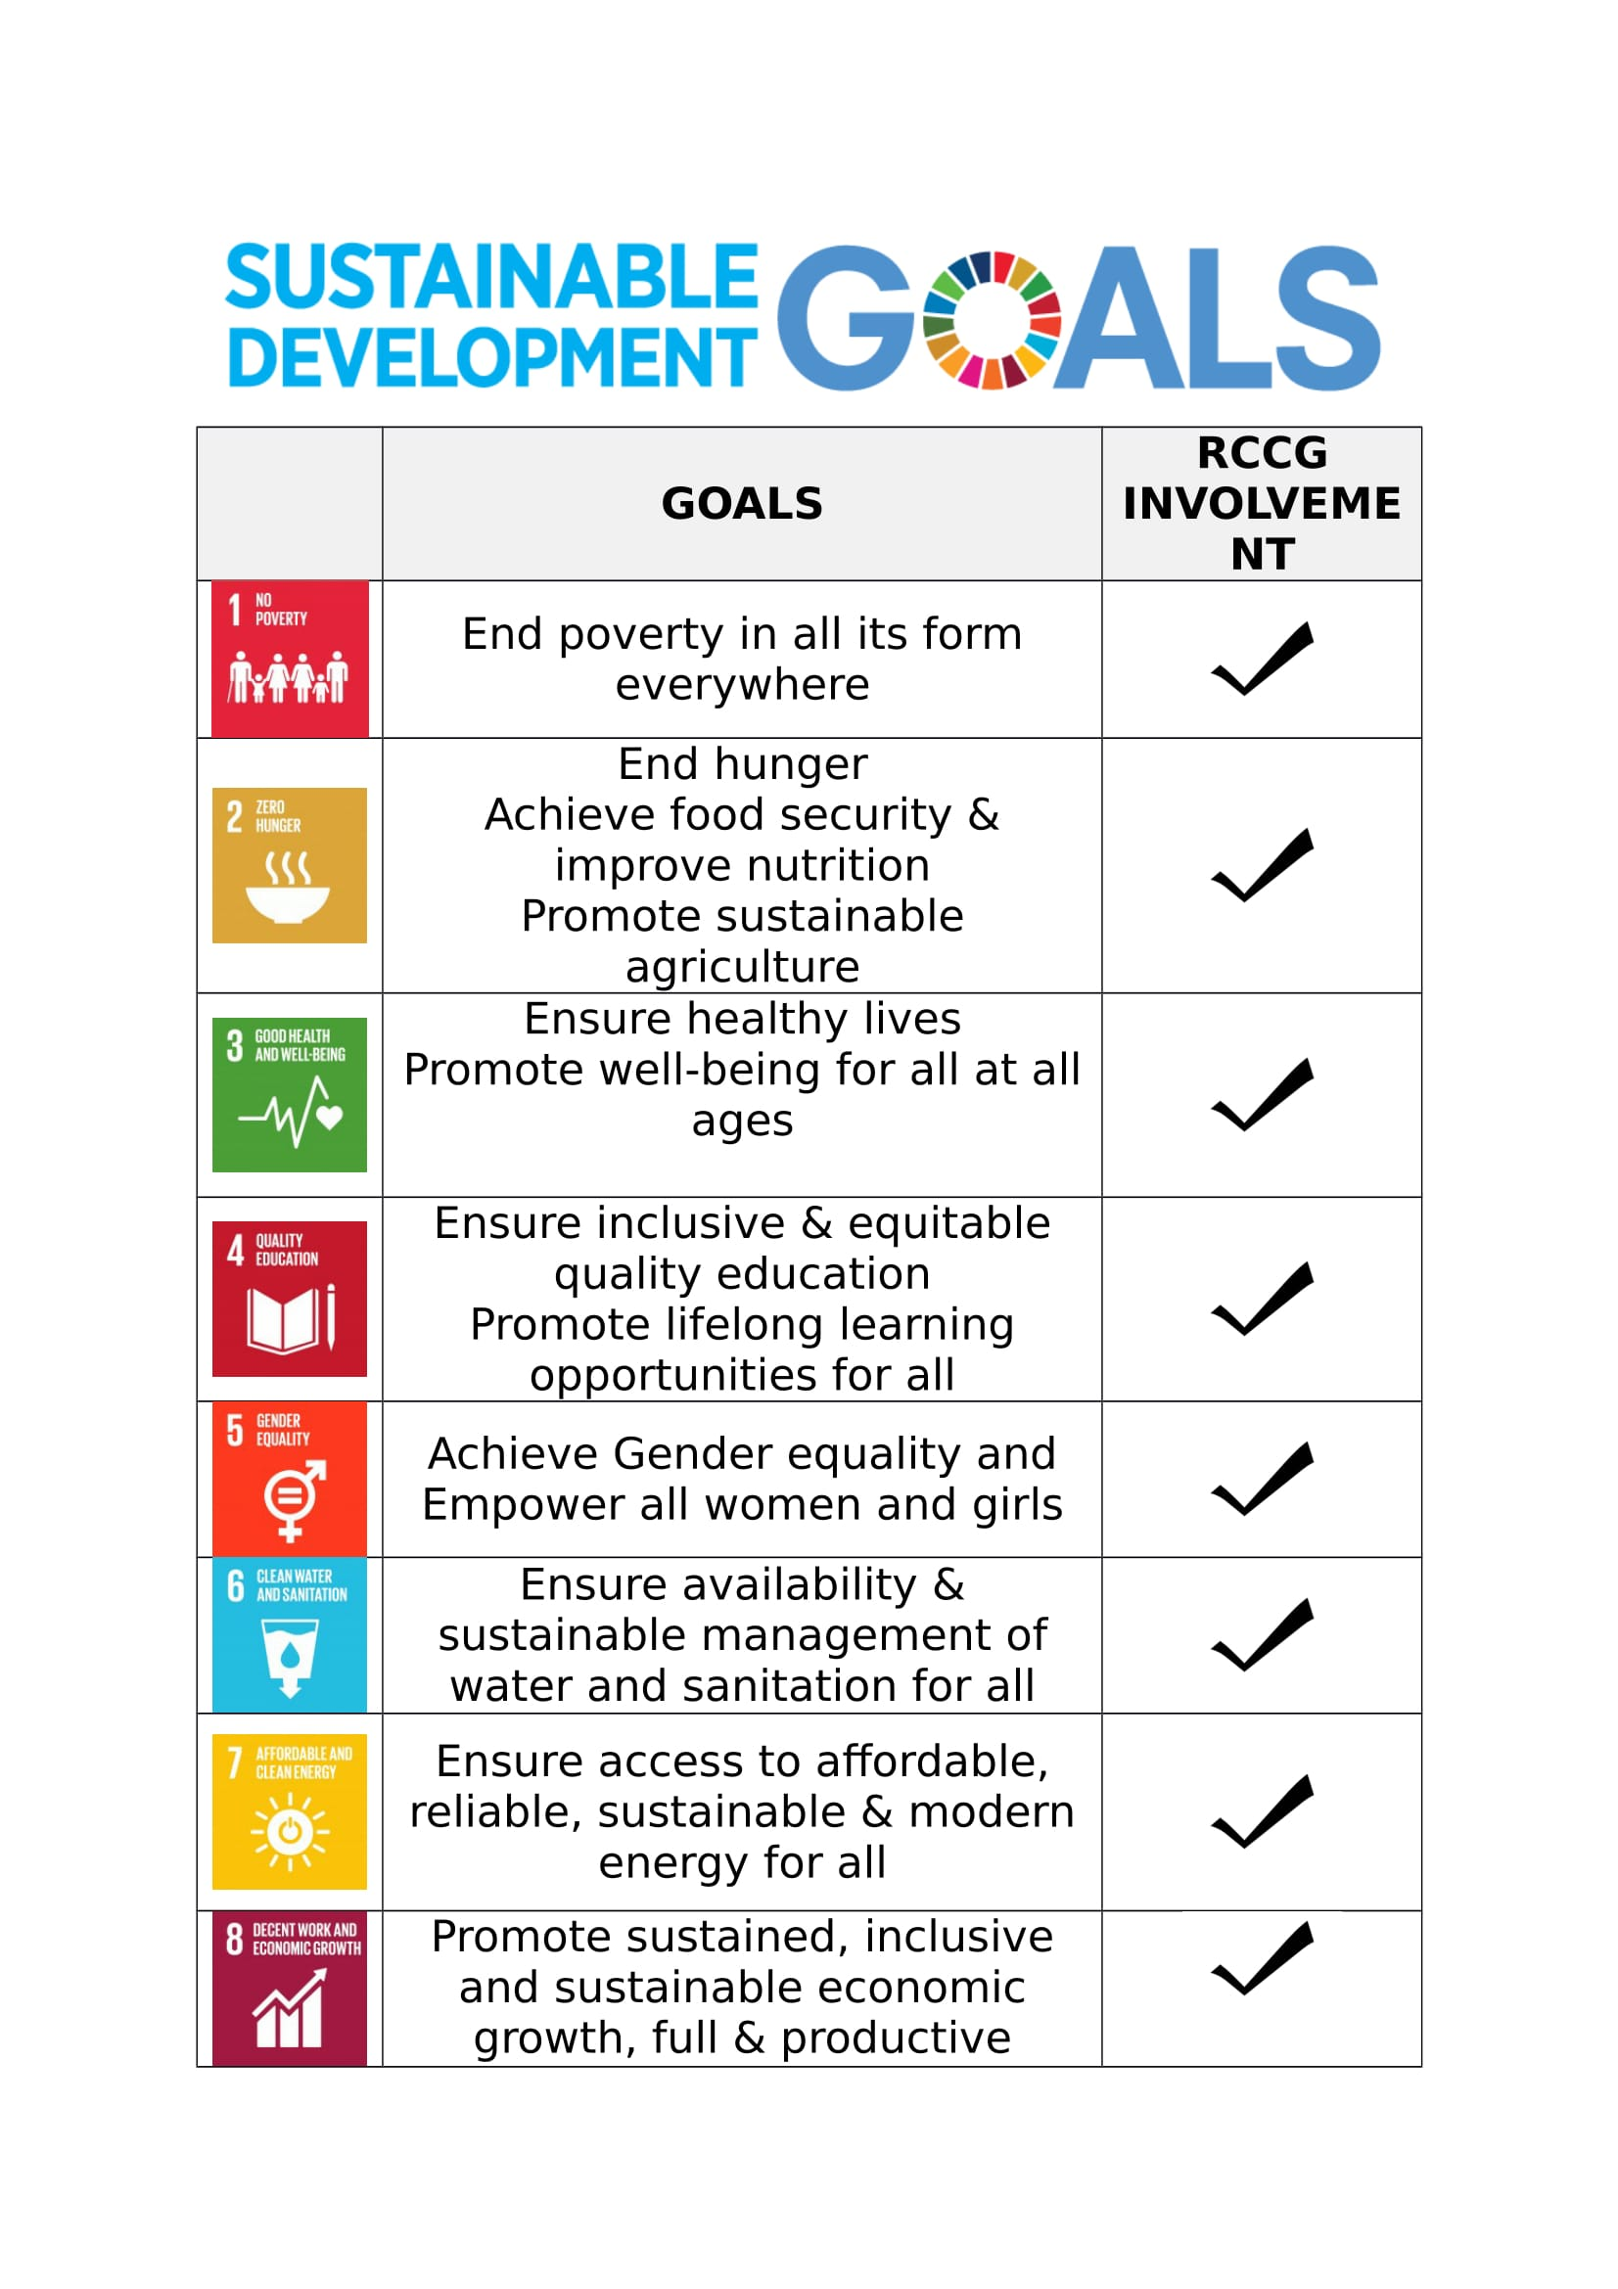
#RCCGLoveInAction

Slide 19
Scriptural Foundation
#RCCGLoveInAction

Slide 20
Scriptural Foundation: CSR – A Matter of Life & Death, Heaven & Hell
Matthew 25:31,32,41-46 KJV
PREVIEW OF JUDGEMENT DAY
31. When the Son of man shall come in his glory, and all the holy angels with him, then shall he sit upon the throne of his glory:
³² And before him shall be gathered all nations: and he shall separate them one from another, as a shepherd divideth his sheep from the goats:
⁴¹ Then shall he say also unto them on the left hand, Depart from Me, ye cursed, into everlasting fire, prepared for the devil and his angels:
#RCCGLoveInAction

Slide 21
⁴² For I was an hungered, and ye gave me no meat: I was thirsty, and ye gave me no drink:
⁴³ I was a stranger, and ye took me not in: naked, and ye clothed me not: sick, and in prison, and ye visited me not.
⁴⁴ Then shall they also answer him, saying, Lord, when saw we thee an hungered, or athirst, or a stranger, or naked, or sick, or in prison, and did not minister unto thee?
⁴⁵ Then shall he answer them, saying, Verily I say unto you, Inasmuch as ye did it not to one of the least of these, ye did it not to me.
⁴⁶ And these shall go away into everlasting punishment: but the righteous into life eternal.
Scriptural Foundation: CSR – A Matter of Life & Death, Heaven & Hell
#RCCGLoveInAction

Slide 22
Job 29:12-16
¹² Because I delivered the poor who cried, the fatherless and him who had none to help him.
¹³ The blessing of him who was about to perish came upon me, and I caused the widow’s heart to sing for joy.
¹⁴ I put on righteousness, and it clothed me or clothed itself with me; my justice was like a robe and a turban or a diadem or a crown!
¹⁵ I was eyes to the blind, and feet was I to the lame.
¹⁶ I was a father to the poor and needy; the cause of him I did not know I searched out.
Scriptural Foundation: CSR – A Matter of Life & Death, Heaven & Hell
#RCCGLoveInAction

Slide 23
Revelation 14:13
And I heard a voice from heaven saying unto me, Write, Blessed are the dead which die in the Lord from henceforth: Yea, saith the Spirit, that they may rest from their labours; and their works do follow them
Scriptural Foundation: CSR – A Matter of Life & Death, Heaven & Hell
#RCCGLoveInAction

Slide 24
James 1:27
Pure religion and undefiled before God and the Father is this, To visit the fatherless and widows in their affliction, and to keep himself unspotted from the world.
Scriptural Foundation: CSR – A Matter of Life & Death, Heaven & Hell
#RCCGLoveInAction

Slide 25
Luke 16:19-31
The Rich Man and Lazarus
Scriptural Foundation: CSR – A Matter of Life & Death, Heaven & Hell
#RCCGLoveInAction

Slide 26
Vision Statement
Your vision should not just be to motivate because motivation only lasts as long as the incentives does.
Your vision should be bold and inspiring because inspiration is a matter of the heart that lasts a lifetime and beyond.
#RCCGLoveInAction

Slide 27
Vision Statement
Inspiration creates a burning passion and drive that makes you see a compelling future that gets you committed with your heart, energy, time, resources or skills to drive the dream of the future to reality.
#RCCGLoveInAction

Slide 28
Vision Statement
Your vision must inspire them to join a cause. The cause that speaks to their values, a cause bigger than you, something real; something worth living for or dying for.
It was said of the Christians of old that they did not love their lives even unto death (Revelations 12:11). That is the standard.
#RCCGLoveInAction

Slide 29
RCCG VISION
1. To make heaven
2. To take as many people with us.
3. To have a member of RCCG in every family of all nations
#RCCGLoveInAction

Slide 30
RCCG MISSION
To accomplish No.1 above, holiness will be our lifestyle
To accomplish No 2 and 3 above, we will plant churches within five minutes walking distance in every city and town of developing countries and within five minutes driving distance in every city and town of developed countries.
We will pursue these objectives until every nation in the world is reached for the lord Jesus Christ.
#RCCGLoveInAction

Slide 31
It paints a picture of heaven- every believer’s goal. We must make heaven- it is compelling.
But how can you take as many people with you to heaven unless your preaching is practical and relevant to them.
Its one thing to preach love, its another to do love.
#RCCGLoveInAction

Slide 32
The ministry of Jesus was all about caring, sharing, healing, deliverance and setting captives free.
He preached and fed over 5000 and his ministry grew exponentially. He showed love through his actions.
After he fed 5000 people in John 6:10, the next day the people looked for Jesus and entered ships to Capernaum. When he saw them, he told them in v.26 that I know you did not come for the miracles but for food.
#RCCGLoveInAction

Slide 33
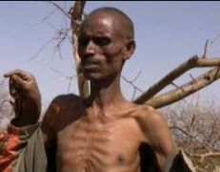
Hunger is a leveler – cuts across Religion, Race, Age & Creed
A HUNGRY MAN will not listen to you, and a hungry man CANNOT SHOUT HALLELUYAH
#RCCGLoveInAction

Slide 34
James 2:14-16
¹⁴ What doth it profit, my brethren, though a man say he hath faith, and have not works? can faith save him?
¹⁵ If a brother or sister be naked, and destitute of daily food,
¹⁶ And one of you say unto them, Depart in peace, be ye warmed and filled; notwithstanding ye give them not those things which are needful to the body; what doth it profit?
Scriptural Foundation: CSR – A Matter of Life & Death, Heaven & Hell
#RCCGLoveInAction

Slide 35
THE EARLY CHURCH:
Passionate about God and the needs of others.
Acts 6:1-7 Daily feeding etc.
Missionary penetration in Africa through CSR.
Catholic church; Anglican Communion method of church etc.- Education, Healthcare and Welfare .
#RCCGLoveInAction

Slide 36
CMS Grammar School, Hope Waddell Training Institute Calabar, St Gregory’s College, Barewa college Zaria.
St. Anne’s School Ibadan, Dennis Memorial Grammar School Onitsha, St John’s School, Bida, Christ School. Ado Ekiti.
Education is a fundamental principle for transforming human lives- same model used by the evangelicals globally.
#RCCGLoveInAction

Slide 37
CSR VISION STATEMENT
To be the global model for meeting the ever evolving
socio economic needs.
#RCCGLoveInAction

Slide 38
CSR MISSION STATEMENT
To express the love of God through visible initiatives that deliver tangible outcomes in societies globally.
#RCCGLoveInAction

Slide 39
Core Values
Compassion – meeting the needs of people
Transformation – working towards positively changing lives
Integrity - conducting our business in accordance with the highest standards of professional behavior and ethics.

Slide 40
MODUS OPERANDI
BEFORE WE EMBARK ON ANY PROJECT- A NEEDS ASSESSMENT MUST BE CONDUCTED
No Coal to Newcastle/ Pounded Yam to Ilesha
#RCCGLoveInAction

Slide 41
NEEDS ASSESSMENT – OUTCOME (HUNGER)
Nearly 811 million people worldwide are malnourished as of 2020, according to UN reports.
We have 30 feeding centres in Nigeria, giving free food to people evry single day.
#RCCGLoveInAction

Slide 42
NEEDS ASSESSMENT – OUTCOME (HEALTH)
Nearly 811 million people worldwide are malnourished as of 2020, according to UN reports.
Kidney Diseases represent 8-10% of hospital admissions in Nigeria.
Over 25 million Nigerians have kidney related medical challenges.
Over 100,000 Nigerians need dialysis daily to stay alive.
However, there are only 160 nephrologists (Kidney specialist) operating in Nigeria to a population of over 200 million people.
#RCCGLoveInAction

Slide 43
NEEDS ASSESSMENT – OUTCOME (HEALTH)
To take care of the over 25 million patients, there are about only 184 functioning Dialysis machines in the whole of the country.
The case burden for Kidney disease management is quite heavy, but with the special grace of God, the Christian Social Responsibility arm of the Redeemed Christian Church Of God will continue to uphold the divine mandate of our Lord and Saviour that... I was sick and you visited me. (Matthew 25: 36).
#RCCGLoveInAction

Slide 44
NEEDS ASSESSMENT – OUTCOME (HEALTH)
As of January 2022, the Redeemed Christian Church of God through our Foundation manages and has donated 30 Dialysis Machines in Nigeria.
This constitutes 15 % of the total operational Dialysis machines in the country.
#RCCGLoveInAction

Slide 45
POST NEEDS ASSESSMENT (HEALTH)
His Love Foundation is about to commission two dialysis centers in this locations in our mission to cover the 36 states in Nigeria
Abuja : Wuse District Hospital
Bauchi :Abubakar Tafawa Balewa Teaching Hopital Bauchi
#RCCGLoveInAction

Slide 46
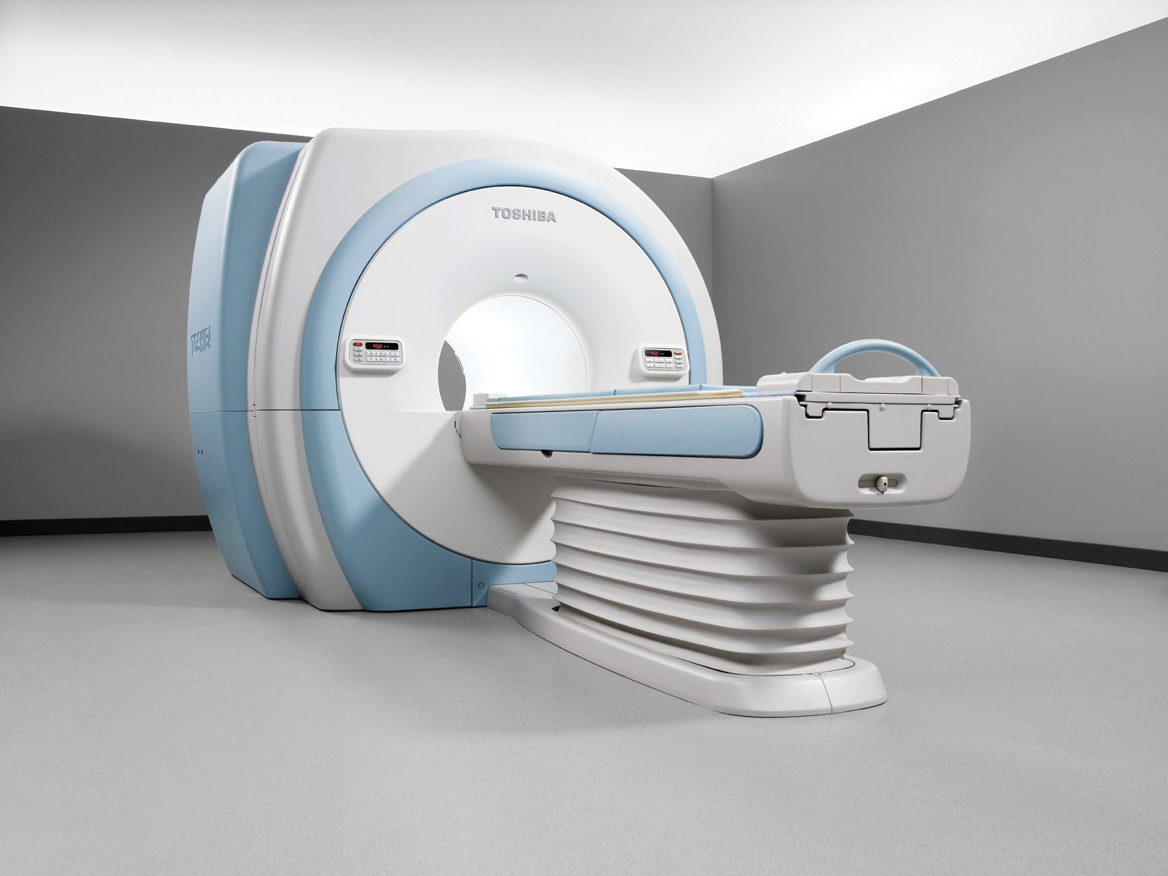
POST NEEDS ASSESSMENT (HEALTH)
MRI Machines (Magnetic Resonance Imaging)
The inspection of centres for the installation of the MRI machines by our foreign partners have been done.
The partners intend to bring in a total of 100 MRI machines, to be placed in hospitals all over the nation. With 3 in Lagos in 2022.
#RCCGLoveInAction

Slide 47
SECTION B

Slide 48
THE WHEEL- EIGHT SPHERES OF INFLUENCE (SHEMBAGS)
A holistic approach to CSR will be driven through a framework which covers all areas of human endeavours i.e. Social, Health, Education, Media, Business, Art/Entertainment, Government and Sports (SHEMBAGS)
#RCCGLoveInAction

Slide 49
SOCIAL
Social relates to human society, the interaction of the individual and the group, or the welfare of human beings as members of the society
It pertains to the life, welfare and relations of human beings in a community
Investing in programmes and solutions that are focused on meeting societal needs
#RCCGLoveInAction

Slide 50
THE ELEMENTS OF SOCIAL
Feeding & Skills Acquisition
Prison outreaches
Orphanage outreaches
Charity shop- clothing, furniture, toys – its new to me
Drug rehabilitation
Shelter for abused women
Juvenile delinquency
Environment architecture
Social enterprise / empowerment / cottage industry
Disaster relief
#RCCGLoveInAction

Slide 51
HEALTH
The World Health Organisation defines health as a "state of complete physical, mental, and social well-being and not merely the absence of disease" (WHO, 2010).
#RCCGLoveInAction

Slide 52
The Elements of Health
1. Health Awareness Programs/Advocacy & Medical Outreach/Let’s go a-fishing
2. Health Institution/ Clinics/Maternity
3. Drug Abuse Rehabilitation Centers
4. Health Intervention areas (Medical Tourism, Ambulances, Mercy Ship)
#RCCGLoveInAction

Slide 53
The Elements of Health
5. Medical Insurance
6. Health Maintenance Organizations (HMO)
7. Medical Equipment
8. Mental Health
9. Specialists Hospitals
10. Water/Hygiene/Sanitation
11. Health Facilities & Infrastructure
#RCCGLoveInAction

Slide 54
EDUCATION
Education is a fundamental principle for transforming human lives
#RCCGLoveInAction

Slide 55
The Elements of Education
1.RCCG Schools – Bridging the equipment and infrastructural gaps 263 RCCG Schools
2.Fortress Schools
3. Build-a-school
4.Equip-a-School
5. Mentor-a-School
#RCCGLoveInAction

Slide 56
The Elements of Education
6. Adopt-a-School
7. Creche/Nursery/Primary/Secondary Schools
8. Higher Institution/Polytechnic/University Endowment/Infrastructural Gaps
9. Vision 2025 – Eradication of Illiteracy
10. Domestic Staff Education
11. Adult Education
#RCCGLoveInAction

Slide 57
MEDIA & COMMUNICATION
Media is the process and means of mass communication to audiences via selected platforms.
Communication is the effective impartation and exchange of information to and with stakeholders
#RCCGLoveInAction

Slide 58
The Elements of Media and Communication
1.E-Communication Hub (Content Development and Management Media)
2. TV Channels
3. Print Media & Publication (Magazines, Newspaper, Bulletins)
4. Web/Online/Social Media Communication
5. Radio Stations
6. Relationship Management- Internal Stakeholders
7. Relationship Management - External Stakeholders
8. Media Relation Management
9.Community Relation Management
#RCCGLoveInAction

Slide 59
BUSINESS AND THE ECONOMY
The management of the resources of an individual or a community, as it affects businesses and enterprises with a view to enhancing its productivity.
#RCCGLoveInAction

Slide 60
The Elements of Business and The Economy
Social enterprise/ Empowerment/ Cottage industry revolution
Business Education
Cooperative Societies
Skills Acquisition and Training
Business Advocacy
Empowerment Programmes
#RCCGLoveInAction

Slide 61
ARTS, CULTURE & ENTERTAINMENT
Arts – The expression of creative talent that is positively inspirational, informational, educational
and engaging
Culture – The projection of positive values, beliefs, and lifestyles that promote decency and
Transformational change among social, ethnic and age groups
Entertainment – The creation and dissemination of products and platforms that positively inspire, inform and engage audiences of all ages.
#RCCGLoveInAction

Slide 62
The Elements of Arts, Culture and Entertainment
Regional Talent Competition
Reach the Millennial
Recreational centres
Active talent development & Promotion
Documentaries, Dramas, Movies, Soap Operas, Theatres, etc.
#RCCGLoveInAction

Slide 63
GOVERNANCE & POLITICS
We are to positively influence governance by encouraging political awareness through civic education, voter participation and leadership in the political process.
#RCCGLoveInAction

Slide 64
The Elements of Governance and Politics
Conducting Services for Governments & their Agencies
Civic Education and Empowerment
Leadership and Governance Academy
Seminars and Conferences
Strategic Engagement with Government and influencers
#RCCGLoveInAction

Slide 65
SPORTS
Supporting initiatives that contribute to sustainable sports development
#RCCGLoveInAction

Slide 66
The Elements of Sports
Sports Infrastructure Development
Sports Academy - Identify young talents for further development
Sports Education
Professional Sports Clubs
Regional Sports Associations
Neighbourhood Sporting Clubs
Sports Foundation
#RCCGLoveInAction

Slide 67
SECTION C

Slide 68
IMPACT ASSESSMENT
&
BENEFICIARIES

Slide 69
2018-2022
TOTAL IMPACTED
137,754,884
Beneficiaries
#RCCGLoveInAction

Slide 70
BENEFICIARIES | 2018 | 2019 | 2020 | 2021 | 2022
SOCIAL | 5,822,271.00 | 16,711,015.00 | 20,612,577.00 | 81,973,849 | 1,730,602
HEALTH | 157,829.00 | 697,407.00 | 666,859.00 | 1,929,057 | 27,873
EDUCATION | 72,159.00 | 165,861.00 | 54,307.00 | 530,262 | 9,195
MEDIA COMM. | 6,879.00 | 37,943.00 | 44,748.00 | 114,814 | 5,979
BUSINESS | 20,034.00 | 64,006.00 | 24,671.00 | 135,491 | 1,305
ARTS & CULTURE | 113,595.00 | 181,247.00 | 181,327.00 | 768,479 | 21,462
GOVERNANCE | 4,535.00 | 23,591.00 | 6,580.00 | 42,319 | 2,227
SPORTS | 27,625.00 | 37,962.00 | 21,766.00 | 107,317 | 1,446
NATIONAL | 6,224,927.00 | 17,919,032.00 | 21,612,835.00 | 85,601,588 | 87,401,677
CSR OFFICE | 49,984,762.00 | 2,805,373.00 | 8,992,670.00 | 50,353,867.00 | 50,353,546.00
GRAND TOTAL | 56,209,689.00 | 20,724,405.00 | 30,605,505.00 | 135,955,455 | 137,754,884

Slide 71
2018-2022
TOTAL AMOUNT SPENT
N25,072,420,601
#RCCGLoveInAction

Slide 72
AMOUNT SPENT (N)
DETAILS | CSR | NATIONAL | TOTAL
2018 | 215,698,727.87 | 2,097,380,093.00 | 2,313,078,820.87
2019 | 427,299,509.05 | 5,159,163,953.00 | 5,586,463,462.05
2020 | 443,981,231.13 | 6,133,472,018.00 | 6,577,453,249.13
2021 | 181,266,293 | 9,006,769,425 | 9,188,035,718
2022 | 30,602,500 | 1,281,292,105 | 1,281,292,105
TOTAL | 1,268,245,760 | 23,773,572,341 | 25,072,420,601

Slide 73
2018-2022
TOTAL CSR PROJECTS 795,347
#RCCGLoveInAction

Slide 74
TOTAL NO. OF CSR PROJECTS
SOCIAL | 2018 32,060 | 2019 138,601 | 2020 232,732 | 2021 299,579 | 2022 32,838 | TOTAL 732,944
HEALTH | 1,612 | 6,567 | 9,487 | 11,270 | 939 | 28,528
EDUCATION | 855 | 3,808 | 3,194 | 5,489 | 602 | 13,940
MEDIA&COMM. | 54 | 304 | 501 | 578 | 79 | 1,522
BUSINESS | 415 | 1,606 | 1,628 | 2,118 | 151 | 5,924
ARTS & CULTURE | 568 | 2,539 | 3,275 | 4,030 | 461 | 10,834
GOVERNANCE | 45 | 123 | 132 | 156 | 14 | 469
SPORTS | 157 | 448 | 223 | 321 | 26 | 1,186
TOTAL | 34,545 | 153,018 | 249,133 | 323,541 | 35,110 | 795,347

Slide 75
THE CHALLENGES
#RCCGLoveInAction

Slide 76
CHALLENGES
POOR QUALITY OF REPORTING
#RCCGLoveInAction

Slide 77
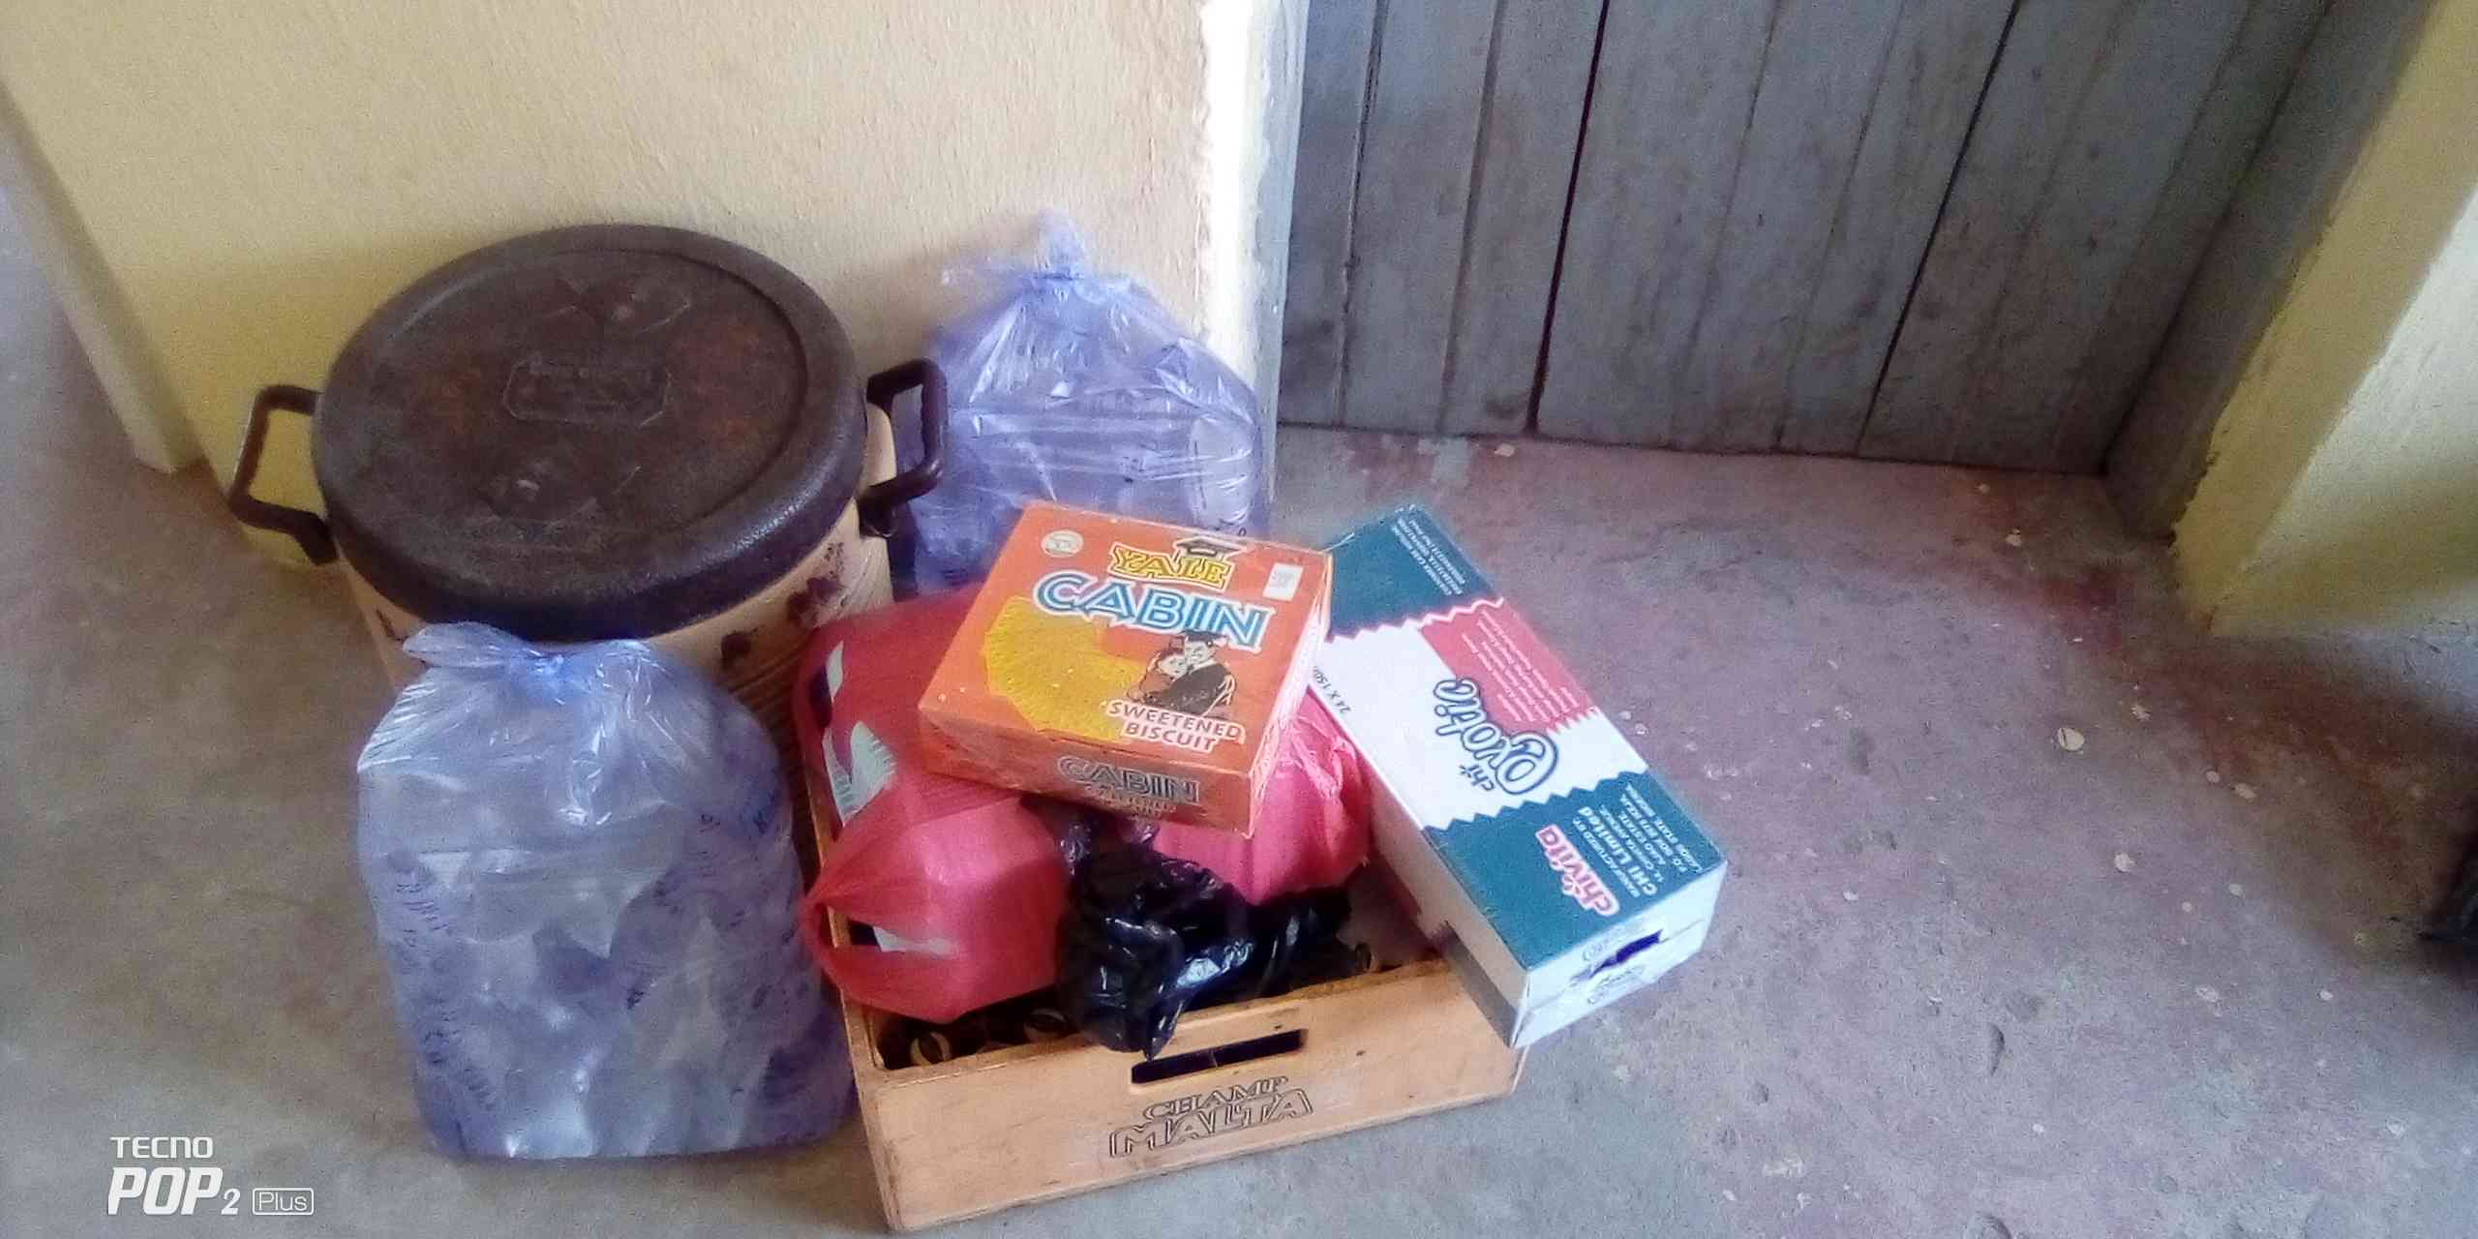
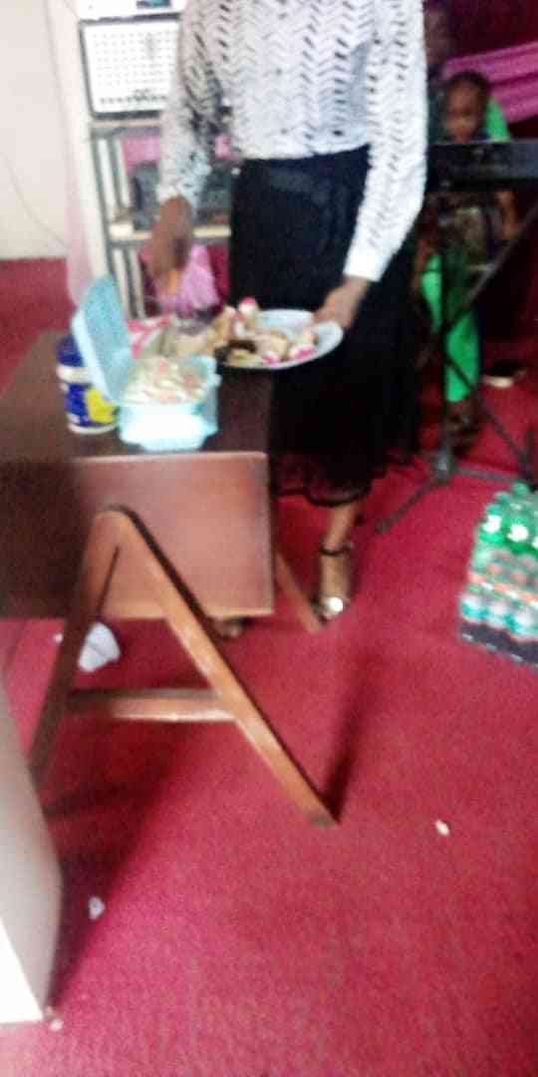
POOR QuALITY OF PICTURES & VIDEOS ON THE REPORTING PORTAL

Slide 78
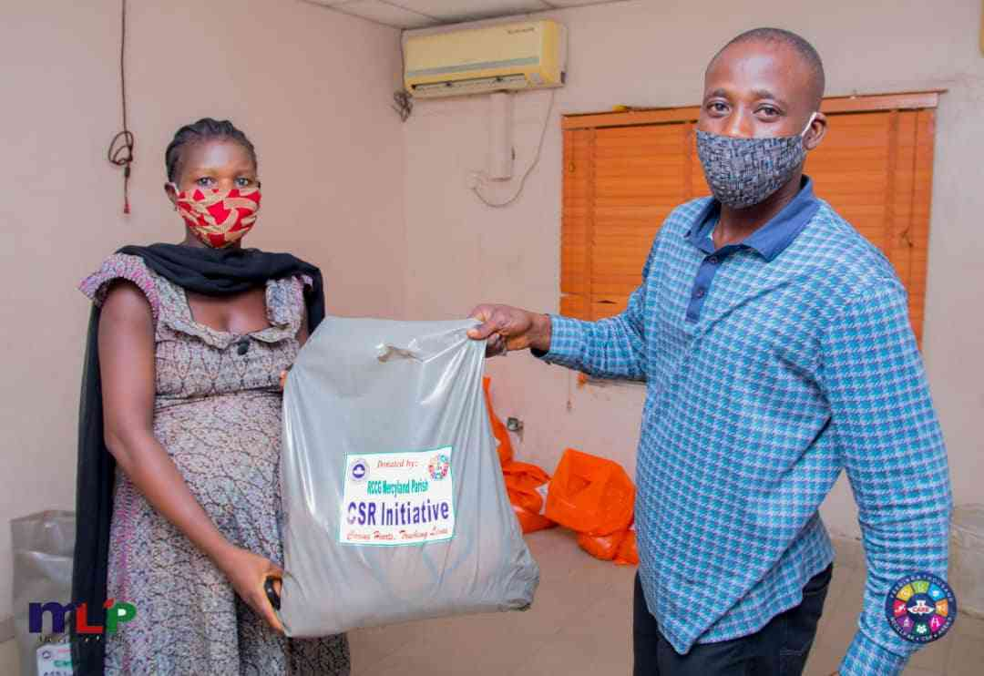
THE PICTURE MUST TELL A COMPLETE STORY
THE RIGHT WAY
THE PICTURE MUST BE CLEAR AND ENGAGING
THE FOCUS MUST BE ON THE BENEFICIARIES AND THE BENEFITS

Slide 79
CHALLENGES
NON-PAYMENT OF MONTHLY REMMITANCE BY PARISHES
#RCCGLoveInAction

Slide 80
ABOUT 25% OF PARISHES DO NOT PAY THEIR STATUTORY CSR MONTHLY CONTRIBUTIONS AT ALL.
#RCCGLoveInAction

Slide 81
CHALLENGES
POOR COMMUNICATION OF CSR ACTIVITIES (A CASE OF WINKING IN THE DARK)
#RCCGLoveInAction

Slide 82
THE WORLD IS A GLOBAL VILLAGE, THE CSR ACTIVITIES OF A PARISH IF WELL CHRONICLED ON SOCIAL MEDIA CAN REVERBERATE AROUND THE WORLD
#RCCGLoveInAction

Slide 83
CHALLENGES
THE VARIANCE BETWEEN INFLOWS AND THE NEEDS ASSESSMENT
#RCCGLoveInAction

Slide 84
THE NEEDS WE ARE FACING FAR EXCEEDS OUR INFLOWS.
#RCCGLoveInAction

Slide 85
CHALLENGES
FOCUSING ON FEEDING AS A LOW HANGING FRUIT HAS BECOME A DISADVANTAGE
#RCCGLoveInAction

Slide 86
FEEDING
67% OF CSR EXPENDITURE IS SKEWED TOWARDS FEEDING
IN THE LAST FOUR YEARS WE HAVE SPENT OVER N16 BILLION ON FEEDING, WHILST THE OTHER INITIATIVES HAVE GULPED OVER N4 BILLION
#RCCGLoveInAction

Slide 87
FEEDING
APART FROM FEEDING, WE SHOULD EQUALLY FOCUS ON OTHER INITIATIVES.
SOCIAL - PRISONS/ORPAHANGE/CHARITY SHOPS/EMPOWERMENT/JUVENILE DELIQUENCY/
#RCCGLoveInAction

Slide 88
HEALTH
EDUCATION
MEDIA & COMMUNICATION
BUSINESS & ECONOMY
ARTS & CULTURE
GOVERNANCE & POLITICS
SPORTS
#RCCGLoveInAction

Slide 89
CHALLENGES
SIGNATURE PROJECTS
#RCCGLoveInAction

Slide 90
THERE IS A DEARTH OF SIGNATURE PROJECTS BECAUSE THE PROVINCES AND REGIONS THAT ARE TO EMBARK ON SUCH PROJECTS ARE NOT PRIORTISING THEM.
EVERY REGION/PROVINCE MUST EMBARK ON SIGNATURE PROJECTS AS A MATTER OF PRIORITY
#RCCGLoveInAction

Slide 91
THE WAY FORWARD (1)

Slide 92
100% REPORTING OF CSR ACTIVITIES ACROSS BOARD SHOULD BE THE MINIMUM BENCHMARK.
REPORTING COMPLIANCE
#RCCGLoveInAction

Slide 93
PROVINCES ARE TO ENSURE BEFORE CLOSING THE PORTAL FOR THE MONTH THAT ALL PARISHES/AREAS/ZONES/PROVINCES/REGIONS HAVE NOT JUST COMPETELY INPUTED THEIR CSR ACTIVITIES BUT PROVIDE EVIDENCE OF THE PAYMENT OF THE MONTHLY CSR CONTRIBUTIONS.
REPORTING COMPLIANCE
#RCCGLoveInAction

Slide 94
WE MUST ENCOURAGE PARISHES TO COLLECT, UTILISE AND REPORT THE 3RD SUNDAY CSR OFFERING. THIS IS HOW WE ENSURE THAT THE 44,000 OPERATING CENTERS ACTUALLY ENGAGE IN CSR
REPORTING COMPLIANCE
#RCCGLoveInAction

Slide 95
WE MUST BEGIN TO ENGAGE SOME LEVEL OF PROFESSIONAL DOCUMENTATION OF CSR ACTIVITIES IN FORM OF QUALITY PICTURES, VIDEOS AND WRITE-UPS THAT CAN BE USED IN THE POST EVENT REPORTING OF CSR ACTIVITIES AND INITIATIVES
QUALITY PICTURES, VIDEOS & WRITE-UPS
#RCCGLoveInAction

Slide 96
EVERY REGION/PROVINCE MUST HAVE A CSR COMMUNICATION TEAM TO BE LED BY THE APICP CSR. > THEY ARE TO GIVE WIDE AND MAXIMUM PUBLICITY FOR THE CSR ACTIVITIES OF THE PROVINCE
COMMUNICATION
#RCCGLoveInAction

Slide 97
COMMUNICATION
AT LITTLE OR NO COST, WE MUST ENGAGE INSTRUMENTALITIES OF SOCIAL MEDIA PLAFORMS TO PROPAGATE OUR CSR WORKS.
“LET YOUR LIGHT SO SHINE BEFORE MEN, THAT THEY MAY SEE YOUR GOOD WORKS, AND GLORIFY YOUR FATHER WHICH IS IN HEAVEN.” (MATT. 5:14–16.)
#RCCGLoveInAction

Slide 98
COMMUNICATION
ALL REGIONS AND PROVINCES MUST CREATE AND BE ACTIVELY PRESENT ON THE FOLLOWING SOCIAL MEDIA PLATFORMS.
FACEBOOK 5. TIKTOK
INSTAGRAM 6. LINKEDIN
YOUTUBE 7. TWITTER 8. WHATSAPP
SNAPCHAT 9. EMAIL (NEWSLETTER)
#RCCGLoveInAction

Slide 99
COMMUNICATION
THERE MUST BE A SOCIAL MEDIA REPORTING DAY ONCE A MONTH : LAST SUNDAY OF THE MONTH AND WE USE THE #LOVEINACTION.
WE ARE TO USE THE #LOVEINACTION FOR ALL OUR POSTINGS ON THAT DAY.
#RCCGLoveInAction

Slide 100
REGIONS AND PROVINCES MUST PUBLISH PERIODICALLY THEIR OWN CSR MAGAZINES (ONLINE) AND GIVE MAXIMUM PUBLICITY IN THE MEDIA (BOTH MAIN & SOCIAL) FOR THEIR SIGNATURE PROJECTS.
COMMUNICATION
#RCCGLoveInAction

Slide 101
WE HAVE OPENED A CSR WHATSAPP PAGE FOR REGIONS AND PROVINCES TO REPORT THEIR SIGNATURE PROJECTS, APART FROM PUTTING THEM ON THE PORTAL FOR EASE OF DISEMMINATION. THE WHATSAPP PAGE IS NAMED ‘CSR PROJECTS’ AND WE ARE ENLISTING ALL APICP CSR TO POST THEIR INITIATIVES AS THEY OCCUR
COMMUNICATION
#RCCGLoveInAction

Slide 102
NOT ALL CSR INITIATIVES INVOLVES SPENDING OF MONEY
FAMILIARISE YOURSELF WITH THE OPERATIONAL MANUAL SO THAT YOU CAN IDENTIFY THE PLETHORAL OF INITIATIVES THAT CAN BE EMBARKED UPON AT LITTLE OR NO COST.
#RCCGLoveInAction

Slide 103
THE WAY FORWARD (2)
Needs assessment;
Youth Perspective; CSR, Social Justice
#RCCGLoveInAction

Slide 104
FOR US TO FULLFIL THE MANDATE OF THE MISSION, WE MUST WIDEN OUR FUNDS NET TO ENCOURAGE AND MOBILISE OUR MEMBERS AND THE CITIZENRY TO PARTNER WITH US IN PROVIDING HELP TO THE HELPLESS
HIS LOVE FOUNDATION- CROWDFUNDING
#RCCGLoveInAction

Slide 105
HIS LOVE FOUNDATION- CROWDFUNDING
WE HAVE THE APPROVAL OF OUR FATHER IN THE LORD TO COMMENCE A GLOBAL CROWDFUNDING CAMPAIGN THAT WILL HELP IN SCALING UP OUR SIGNATURE PROJECTS DRIVE SIGNIFICANTLY
#RCCGLoveInAction

Slide 106
HIS LOVE FOUNDATION- CROWDFUNDING
HOW TO BE A PARTNER
#RCCGLoveInAction

Slide 107
HIS LOVE FOUNDATION- CROWDFUNDING
#RCCGLoveInAction

Slide 108
HIS LOVE FOUNDATION- CROWDFUNDING
#RCCGLoveInAction

Slide 109
WHAT’S IN IT FOR ME?
OUR LIGHT IS YOUR LIGHT
#RCCGLoveInAction

Slide 110
CONCLUSION
“AND WHOSOEVER SHALL GIVE TO DRINK UNTO ONE OF THESE LITTLE ONES A CUP OF COLD WATER ONLY, IN THE NAME OF A DISCIPLE, VERILY I SAY UNTO YOU, HE SHALL IN NO WISE LOSE HIS REWARD.”
MATHEW 10:42
#RCCGLoveInAction

Slide 111
VIDEOS

