Slide 1
STRATEGIZE FOR RELEVANCE: CSR AS A VEHICLE USING RCCG AS A CASE STUDY
PASTOR IDOWU ILUYOMADE (INTERCONTINENTAL OVERSEER CSR)

Slide 2
Greetings – Annual Empowerment Conference 2021
The AGO Admin and Personnel
The National Overseer
All Continental Overseers
All Pastors

Slide 3
STRATEGIZE FOR RELEVANCE; CSR AS A VEHICLE
Looking at this topic, it could throw up the question –
‘Can you use CSR as a strategy to stay relevant?
The key words here are ‘Strategy’ & ‘Relevance’.

Slide 4
What is Strategy?
A plan of action designed to achieve a long-term or overall aim.

Slide 5
WHAT IS RELEVANCE?
Relevance is the degree to which something is related to what is happening or being talked about.

Slide 6
IRRELEVANCE AS AN ANTONYM OF RELEVANCE
Once you understand the word ‘Irrelevance’, its easier to know the meaning of the word ’Relevance’.

Slide 7
SYNONYMS OF ‘IRRELEVANCE’
Inapplicable | Useless | Immaterial | Inappropriate
Remote | Out of place | Not pertaining to | Outdated
Unimportant | Unnecessary | Unconnected | Pointless
Not suitable

Slide 8
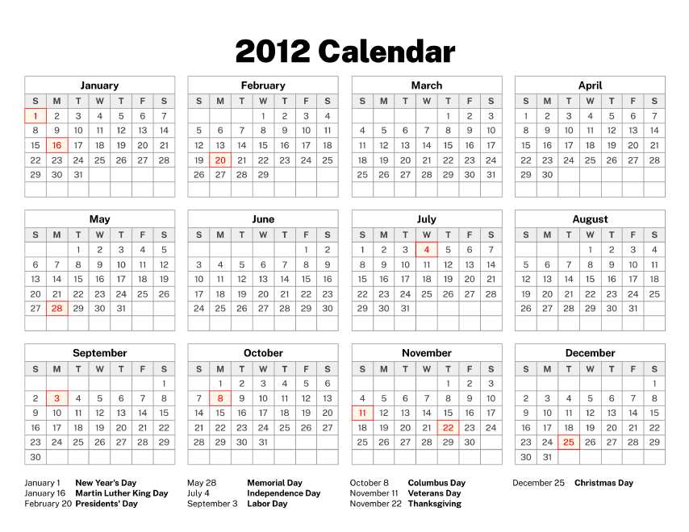
RELEVANCE ILLUSTRATION
A 2012 calendar is not relevant, not suitable, inappropriate, inapplicable, out of place, useless, pointless and outdated for setting appointments in 2021.
Someone responds with '12pm’ when you ask for the temperature outside.

Slide 9
Based on the above understanding, the word ‘Relevance’ now has a new life;
It is used when something matters;
When it is important;
When it is needed;
When it is useful to the matter at hand.

Slide 10
Our AIM!
Our aim in strategising is to stay relevant through the ages, if you use all the strategies that you formulate and you’re still not relevant, then the whole exercise is futile.
So, in this paper, while we’re going to throw up a lot of strategies, our focus and aim should always be to stay relevant!

Slide 11
RCCG – A Vision
A look at the RCCG Vision shows that the first thing is for us to make heaven, the second vision says to take as many people with us.
This second vision throws up the need for us to be and stay relevant throughout the ages.

Slide 12
The Relevance of the Gospel
The Gospel that we preach even though dated, has stayed relevant for centuries, and although the principle remains the same, the method of dissemination has evolved and changed over time, more so, with the advent of technology.

Slide 13
The Relevance of the Gospel
For people to follow us to heaven, our gospel must be attractive enough to pull them close. If you’re irrelevant; not speaking their language, not meeting their needs, not cutting through all demographics, no one will follow you to heaven, as the gospel we preach will be unconnected and unimportant to our audience.

Slide 14
A Case for Relevance
It was the zeal to stay relevant that drove William Tyndale to translate the Hebrew and Greek Bible into English; he was undeterred even though, he was going to burn at the stake in 1536.
It was the same quest for relevance that took Jesus to the cross, and made the apostles to be martyred.

Slide 15
A Case for Relevance
They were all driven by passion and did not love their lives unto death. They did what was needed to stay relevant in their days.
That is why today, even in China because of the zeal and passion for relevance and change by some evangelists, we have approximately over 100 million Christians in China.

Slide 16
IBI JUS IBI REMEDIUM
Where there is a breach or violation, there must be a way out”
“The thing that hath been, it is that which shall be; and that which is done is that which shall be done: and there is no new thing under the sun” (Ecclesiastes 1:9)
There is no challenge that can come upon you that is new to man, but God is faithful; He will get a remedy so you come out with a testimony (1 Corinthians 10:13)

Slide 17
CSR- How we started…
Prior to January 2018, the church received serious backlash from the media, that we were irrelevant and just taking care of the spiritual needs of the people, setting up churches, wining souls, and only interested in collecting tithes and offerings, thereby impoverishing the parishioners, and not giving back to the society.

Slide 18
CSR- How we started…
Championed by ‘Daddy Freeze’, and this negatively affected the church in all its ramifications. It was obvious to the mission that the church was fast becoming socially irrelevant, in that we were either not meeting the needs of the people, or not doing enough, or the little we’re doing; we were not talking about it.

Slide 19
GLORY BE TO GOD, THE ENEMIES OF THE GOSPEL HAVE NOW BEEN SILENCED! “…THAT THEY WILL SEE YOUR GOOD WORKS AND GLORIFY YOUR FATHER IN HEAVEN”

Slide 20
Christian Social Responsibility
The mission decided to establish the CSR department in January 2018, as a strategic vehicle to drive policy orientation, in a bid to change the narrative.

Slide 21
Christian Social Responsibility
Since C.S.R has its root in Christianity, we moved to establish the acronym ‘Christian Social Responsibility’, as opposed to the then popular ‘Corporate Social Responsibility’.

Slide 22
Christian Social Responsibility
During our research, we discovered that the oldest company in the world ‘Kongo Gumi Construction’ is less than 2000 years old, and was incorporated in 570 AD.

Slide 23
Christian Social Responsibility
The word ‘company’ has its roots in two Latin words ‘Com’ & ‘panies’, which means breaking bread together, thereby showing that the origin of CSR has communal or social connotation which speaks of the way of life of the early Christians (Leviticus 25:35).

Slide 24
Christian Social Responsibility
We pushed this acronym and now it is widely accepted that the appropriate meaning of C.S.R should be ‘Christian Social Responsibility’. This concept has now been utilized both in research, at the doctorate level and in the Consulting sector by Alder Consulting.

Slide 25
What is CSR?
Christian Social Responsibility is a faith-based obligation to meet societal needs through the demonstration of love that positively impacts communities and individuals.

Slide 26
What is CSR?
CSR is a very strategic and veritable evangelical tool used by the early church to penetrate Africa through the provision of welfare, education, and healthcare.

Slide 27
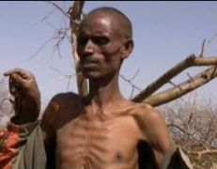
A HUNGRY AND IMPOVERISHED MAN CANNOT SHOUT HALLELUYAH

Slide 28
Today, most of those vehicles used are still existing. We have schools like
CMS Grammar school (1859),
St Gregorys College (1928),
St Annes School Ibadan (1950),
Barewa College Zaria (1921),
Dennis Memorial (1925)and hospitals.
They met the needs of the people and are still relevant today.

Slide 29
Mandate
We were given a mandate to use CSR as a strategic tool to develop a global blueprint for the Redeemed Christian Church of God’s CSR activities, which includes concepts, execution, monitoring, evaluation, communication, and financing of social impact initiatives, in the 197 nations of the mission.

Slide 30
CSR as a tool of Policy thrust
The beauty of using CSR as a tool of policy thrust is that it is the only tool with humongous impact for immediate result and relevance, now in this world and in the world to come.

Slide 31
CSR as a tool of Policy thrust
If you’re looking for sustainability and relevance right up to eternity, the tool to use is CSR.

Slide 32
Jesus told us in Matthew 21:31-32 & 41-46 CSR QUESTIONS!!!
Matthew 25:31-32,41-46 KJV
PREVIEW OF JUDGEMENT DAY
31. When the Son of man shall come in his glory, and all the holy angels with him, then shall he sit upon the throne of his glory:
³² And before him shall be gathered all nations: and he shall separate them one from another, as a shepherd divideth his sheep from the goats:
⁴¹ Then shall he say also unto them on the left hand, Depart from Me, ye cursed, into everlasting fire, prepared for the devil and his angels:

Slide 33
Jesus told us in Matthew 21:31-32 & 41-46 CSR QUESTIONS!!!
⁴² For I was an hungered, and ye gave me no meat: I was thirsty, and ye gave me no drink:
⁴³ I was a stranger, and ye took me not in: naked, and ye clothed me not: sick, and in prison, and ye visited me not.
⁴⁴ Then shall they also answer him, saying, Lord, when saw we thee an hungered, or athirst, or a stranger, or naked, or sick, or in prison, and did not minister unto thee?
⁴⁵ Then shall he answer them, saying, Verily I say unto you, Inasmuch as ye did it not to one of the least of these, ye did it not to me.
⁴⁶ And these shall go away into everlasting punishment: but the righteous into life eternal.

Slide 34
LEADERS HAVE A DIVINE RESPONSIBILITY TO LEAD THE PEOPLE ON THE PATH OF CSR, AS THEY WILL GIVE ACCOUNT OF THEIR STEWARDSHIP ON JUDGEMENT DAY
Hebrews 13:17 KJV - “Obey them that have the rule over you and submit yourselves: for they watch for your souls, as they that must give account, that they may do it with joy, and not with grief: for that is unprofitable for you”.
Hebrews 13:17 NLT- “Obey your spiritual leaders and do what they say. Their work is to watch over your souls, and they are accountable to God. Give them reason to do this with joy and not with sorrow. That would certainly not be for your benefit.

Slide 35
The Engine that drives change is Leadership
It suffices to say that the issue of CSR is a matter of Life and Death, and that was why the mission has put it on the front burner. For us at RCCG, doing CSR is compelling!

Slide 36
This has led us to develop the following strategic mandates-
Initialization and Implementation – To establish and implement a CSR policy for the mission
Coordination – To maintain oversight and coordinate all CSR programs of all the organs of the mission
Harmonization – To harmonize all CSR programs, processes and activities at all levels and arms of the mission for greater impact.
Standardization – To establish, guide and ensure compliance with approved standards

Slide 37
This has led us to develop the following strategic mandates-
5). Communication
To provide the framework for internal and external communication, and drive the overall CSR communication for the mission
To position the mission to demonstrate an active CSR presence in society and communities and to be able to effectively communicate its positive contribution via social media, online platforms, public forums and all other media channels.

Slide 38
Sustainable Development Goals
One of the reasons why this office was created is to harmonize all RCCG Programs, processes & activities for greater impact and relevance.

Slide 39
Sustainable Development Goals
We have discovered that out of the 17 Global Sustainable Development Goals (Vision 2030) signed by 193 Nations including Nigeria, RCCG as a faith-based organization is active in 13 of these.

Slide 40
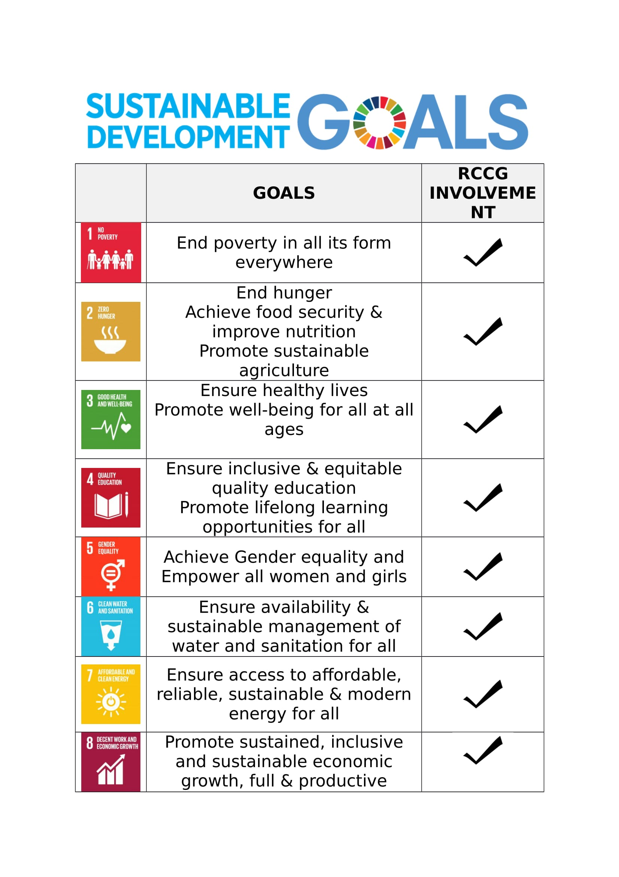

Slide 42
STRATEGIC ROADMAP
A. We constituted a team of technocrats and experts in the field of communication, marketing, CSR, finance, legal etc
B. We engaged renowned consultants with expertise in social transformation campaigns (i.e., Alder Consulting)

Slide 43
STRATEGIC ROADMAP
C. We attended capacity building trainings at the Canadian Institute for CSR, the Lagos Business School etc,
D. We engaged the services of professional consultants for advertising and the development of our communication materials

Slide 44
STRATEGIC ROADMAP
E. We developed the format for reporting CSR activities along the platforms of SHEMBAGS (SOCIAL, HEALTH, EDUCATION, MEDIA, BUSINESS, ARTS AND CULTURE, GOVERNACE AND SPORTS) and also the reporting of financial components on the NATIONAL PORTAL, with a view to capturing all CSR activities being done in the mission.

Slide 45
STRATEGIC ROADMAP
F. We developed the policy document that forms the framework for the execution of CSR activities in the mission

Slide 46
STRATEGIC ROADMAP
G. We developed the Operational Manual as the baseline guide for the execution of CSR activities across the strata of the mission

Slide 47
STRATEGIC ROADMAP
H. The policy document and the operational manual were approved by the mission in March 2018, and we commenced the national training and sensitisation program of the new direction of CSR in the mission, which is still ongoing.

Slide 48
STRATEGIC ROADMAP
I. We developed an electronic training component of both the policy document and operational manual for ease of adoption, by CSR operatives as they come on board.

Slide 49
STRATEGIC ROADMAP
J. We started the publication of CSR activities in the mission, both in print and online, with a view to letting the message of CSR reach the whole world.

Slide 50
STRATEGIC ROADMAP
K. Still on communication, we engaged the instrumentalities of not just the online media, but also the above-the-line media of Tv, radio, newspapers and print communication.

Slide 51
STRATEGIC ROADMAP
L. The mission setup ‘HIS LOVE FOUNDATION’ as the external face of RCCG Charity globally,
M. The foundation started the first global crowdfunding scheme with partnership benefits.

Slide 52
Staying Relevant – Making an Impact?
The word ‘impact’ has been defined as the act of striking one thing with another, giving a noticeable difference.

Slide 53
Staying Relevant – Making an Impact?
If your church is to close-up in your community and leave, if the people miss you, that means you’re relevant and have impacted them positively. However, if they rejoice and say “good riddance to nuisance and bad rubbish”, then obviously you have not made an impact, and your stay has been useless, and not met the needs of your community.
What this says to us is that relevance is measurable.

Slide 54
How effective has the strategic use of CSR over the past 3 years been, in helping the Redeemed Christian Church of God to stay relevant and impactful?

Slide 55
Strategic Intent [CSR Policy]
Statement of Strategy
To implement consolidated and intentional CSR initiatives - SHEMBAGS (Social, Health, Education, Media & Communication, Business & The Economy, Arts, Culture & Entertainment, Government & Politics and Sports) that are coordinated, harmonized and structured for maximum impact and visibility within communities, towns, cities and nations, leveraging on the massive footprint of the Church (Parishes, etc.), its vast intellectual resources and influence.

Slide 56
The Wheel – Eight Spheres of Influence
A holistic approach to CSR will be driven through a framework which covers all areas of human endeavours i.e Social, Health, Education, Media, Business, Art/Entertainment, Government and Sports (SHEMBAGS).
RCCG CSR activities will be focused on these eight broad themes with the goal of improving the overall socio- economic status of its various communities.

Slide 57
SECTION B
MEASUREABLE STRATEGIC RELEVANCE OF CHRISTIAN SOCIAL RESPONSIBILITY TO THE MISSION AND THE SOCIETY

Slide 58
CHURCH GROWTH-RELEVANCE
IT IS AN ESTABLISHED FACT THAT PARISHES THAT ENGAGE IN CHRISTIAN SOCIAL RESPONSIBILITY EXPERIENCE GROWTH BOTH NUMERICALLY AND FINANCIALLY

Slide 59
CHURCH GROWTH –NUMERICAL RELEVANCE
YEAR | GROWTH RATE | ATTENDANCE
2015/2016 | 3.94% | 2,384,112
2016/2017 | 5.4% | 2,512,854
2017/2018 | 11.1% | 2,791,906
2018/2019 | 2.4% | 2,857,119
2019/2020 | (17.57%) (COVID19) | 2,354,987
2020/2021 | 16.91% | 2,729,477

Slide 60
CHURCH GROWTH-SPIRITUAL RELEVANCE (SOULS WON)
YEAR | SOULS WON
2018 | 28,784
2019 | 655,340
2020 | 481,250
2021 | 381,574
Total- 1,546,949 SOULS

Slide 61
SOCIAL IMPACTS - PROJECTS RELEVANCE

Slide 62
SOCIAL IMPACTS-PROJECTS RELEVANCE
NUMBER OF PROJECTS
661,504

Slide 63
SOCIAL IMPACTS-PROJECTS RELEVANCE
NUMBER OF BENEFICIARIES
139,984,345

Slide 64
SOCIAL IMPACTS-PROJECTS RELEVANCE
BREAKDOWN OF BENEFICIARIES
SOCIAL | 136,678,154
HEALTH | 1,823,313
EDUCATION | 388,711

Slide 65
SOCIAL IMPACTS-PROJECTS RELEVANCE
BREAKDOWN OF BENEFICIARIES
MEDIA | 110,391
BUSINESS | 138,748
ARTS AND CULTURE | 709,344
GOVERNMENT | 40,721
SPORTS | 94,963

Slide 66
FINANCE
TOTAL SPENT: 2018-to-date
N22,173,225,708.26

Slide 67
BREAKDOWN ON TOTAL SPENT
DETAILS | 2018 (NAIRA) | 2019 (NAIRA) | 2020 (NAIRA) | 2021 (NAIRA) | TOTAL (NAIRA)
SOCIAL | 1,757,768,202.15 | 4,095,805,546.30 | 5,398,325,551.22 | 6,416,648,728.59 | 17,668,548,028.26
HEALTH | 107,122,960.00 | 429,638,499.50 | 550,250,120.00 | 1,523,700,355.00 | 2,610,711,934.50
EDUCATION | 69,997,490.00 | 335,310,177.50 | 140,807,595.00 | 529,301,264.00 | 1,075,416,526.50

Slide 68
BREAKDOWN ON TOTAL SPENT
DETAILS | 2018 (NAIRA) | 2019 (NAIRA) | 2020 (NAIRA) | 2021 (NAIRA) | TOTAL (NAIRA)
MEDIA/ COMMUNICATION | 1,705,500 | 9,744,165 | 12,602,713 | 17,119,230 | 41,171,608
BUSINESS | 105,211,195 | 106,662,159 | 80,395,866 | 115,392,665 | 407,661,885
ARTS | 29,223,393 | 111,522,387 | 44,409,582 | 48,446,123 | 233,601,485

Slide 69
BREAKDOWN ON TOTAL SPENT
DETAILS | 2018 (NAIRA) | 2019 (NAIRA) | 2020 (NAIRA) | 2021 (NAIRA) | TOTAL (NAIRA)
GOVT. | 2,071,028,740.15 | 29,655,595.00 | 7,946,866.00 | 31,716,991.00 | 84,344,452.00
SPORTS | 12,352,505.00 | 23,579,996.00 | 8,224,405.00 | 7,612,883.00 | 51,769,789.00
TOTAL | 2,098,406,245.15 | 5,141,918,525.30 | 6,242,962,698.22 | 8,689,938,239.59 | 22,173,225,708.26

Slide 70
KNOWLEDGE- RELEVANCE
The Case of Religion and Development in Nigeria through the case of RCCG: By Christopher Wadibia (Cambridge University).
Social Praxis in Holistic Pentecostal Missiology: An Evangelical Perspective on the Mission Practice of the Redeemed Christian Church of God (RCCG) Nigeria: By Francis Adebayo (Vrije University Amsterdam)

Slide 71
KNOWLEDGE- RELEVANCE
Social Praxis in Holistic Pentecostal Missiology: An Evangelical Perspective on the Mission Practice of the Redeemed Christian Church of God (RCCG) Nigeria: By Francis Adebayo (Vrije University Amsterdam)
In 2016, the university did a CSR impact study on Africa and there was no significant work on RCCG
In 2018, the study was repeated, and the story has changed significantly. On the basis of this new information, the university in the Netherlands commissioned this PHD work.

Slide 72
KNOWLEDGE- RELEVANCE
‘A study of Corporate Social Responsibility Practices of selected Organizations in the Delivery of infrastructural Projects in Lagos State Nigeria, By Oluwaseyi O.Alao (Obafemi Awolowo University)
How are the fastest Growing Churches (FGC) In Nigeria intersecting with the poor, with poverty alleviation: Chinyereugo Adeliyi (Asbury Theological Seminary in Wilmore Kentucky USA)

Slide 73
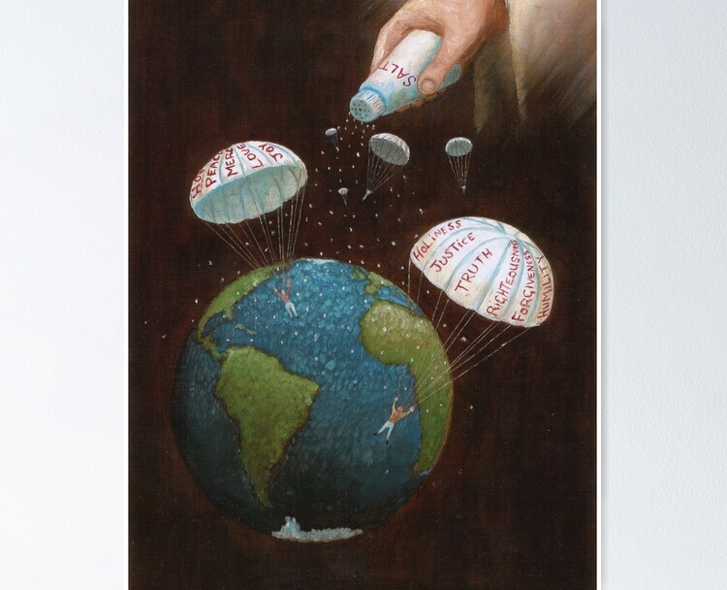
ENVIRONMENTAL RELEVANCE
The Church is the salt of the earth and as changes occur the church remains the only hope of the people.
Therefore, at all times and seasons the church must be at the vanguard of the solution to societal problems.

Slide 74
ENVIRONMENTAL RELEVANCE
“And of the children of Issachar, which were men that had understanding of the times, to know what Israel ought to do, the heads of them were two hundred and all their brethren were at their commandment”
1 Chronicles 12:32

Slide 75
ENVIRONMENTAL RELEVANCE
COVID 19- Global lockdown
Churches were locked down globally, but CSR was not locked down
(1)Global lockdown
(2) Economic contraction
(3) Inflation
But we shine best in darkness

Slide 76
ENVIRONMENTAL RELEVANCE
During the covid pandemic, the church became the only hope of survival and medical intervention for many people.

Slide 77
ENVIRONMENTAL RELEVANCE
Though there was a global lockdown, the church of Jesus Christ was never locked down as our CSR initiatives became the strategic vehicle of intervention in the society.

Slide 78
ENVIRONMENTAL RELEVANCE
Isaiah 60 1:2 – “Arise, shine, for thy light is come, and the glory of the Lord is risen upon thee. 2. For behold, the darkness shall cover the earth, and gross darkness the people: but the Lord shall arise upon thee, and his glory shall be seen upon thee.

Slide 79
ENVIRONMENTAL RELEVANCE
During the Covid-19 pandemic, we were involved in the following
Telemedicine
Drugs Delivery
Stakeholder Engagement on webinars
Robotic training
Adapting to change
Invested a lot in IT to stay relevant

Slide 80
ENVIRONMENTAL RELEVANCE
COVID-19 PANDEMIC PALLIATIVES DISTRIBUTED
68,000 Alcohol-based hand sanitizers
200,000 Hand gloves
80,000 Surgical face mask (all these were donated to health workers at the front line in the fight against COVID-19
N20,000,000 Donations to the Osun state government by the General Overseer to fight the pandemic
Donation of ICU equipment to both Lagos & Ogun state government
Donation of food across Nigeria
Donation of food to prisoners in Correctional facilities in Nigeria

Slide 81
POLITICAL RELEVANCE
Our Initiatives
Faith & Politics
NIN registration in different locations across Nigeria
Voter registration awareness campaign in different locations across Nigeria

Slide 82
POLITICAL RELEVANCE
By our various CSR initiatives that have impacted close to 140million people in Nigeria alone, we have the leverage to influence and direct political opinion in the country.
We must develop proper structure to harness this great opportunity that CSR has availed us.

Slide 83
POLITICAL RELEVANCE
As he that pays the piper dictates the tune, with the influence of CSR and the church being a governing institution, we are supposed to be leading the nation and CSR gives us not only the social capital but most importantly the influential capital.

Slide 84
POLITICAL RELEVANCE
The French revolution was inspired by hunger. We feed hundreds of thousands all over the country, and it’s a known maxim that if you feed people, they will listen to you.

Slide 85
POLITICAL RELEVANCE
We must be dictating the direction of governance in the land and influencing political appointments.

Slide 86
POLITICAL RELEVANCE
Change can only come if we are at the driver’s seat of decision making. This opportunity CSR has given us.

Slide 87
POLITICAL RELEVANCE
We also have the prophesy of our Father in the lord, that no one would become anything in this country, without our consent. CSR is the gateway to the fulfilment of that promise from God.

Slide 88
POLITICAL RELEVANCE
We must stop casting our pearls to swine. We must take charge to occupy till He comes.

Slide 89
SECTION C
PROJECTS

Slide 90
PROJECTS
REGIONS AND PROVINCES ARE TO EMBARK ON SIGNATURE PROJECTS DEPENDING ON THE NEEDS ASSESSMENT OF THEIR COMMUNITIES

Slide 91
FACT SHEET
SIGNATURE PROJECTS

Slide 92
HEALTH
INTENSIVE CARE UNITS
Lagos State University Teaching Hospital, Lagos
Plateau State Specialist Hospital Jos
The Redeemer’s Health Centre, Redemption Camp
Ondo State University of Medical Sciences Teaching Hospital Ondo
Olabisi Onabanjo University of Medical Sciences Teaching Hospital Ogun State

Slide 93
HEALTH
DIALYSIS CENTRES
Healing Stripes Hospital, Victoria Island Lagos
The Redeemer’s Health Centre, Redemption Camp
University College Hospital, Ibadan
Ondo State University of Medical Sciences & Teaching Hospital, Ondo

Slide 94
HEALTH
101,985 free cancer screening
6,703,494 free health care beneficiaries
2,365 completed health projects
12 successful kidney transplants
48,699 completed dialysis sessions

Slide 95
FEEDING
159,535,458 people fed
22 daily feeding centers in Lagos
23,635,187 meals served in Sunday feeding centers
556,646 total meals served in all feeding centers

Slide 96
REHABILITATION
17,144 beneficiaries at Christ Against Drug Abuse Ministry (CADAM)
1,200 beneficiaries at wellspring drug rehabilitation center
6,976 beneficiaries at the Habitation of Hope center for street children
1,632 beneficiaries at the wholistic outreach
41 beneficiaries at Virtuous women rehabilitation center
420 beneficiaries at House of Joy rehabilitation center for boys

Slide 97
EDUCATION
1,244 education projects in Nigeria
1,402,602 student’s scholarship
8 free schools established
5 Enoch Adeboye professorial chairs

Slide 98
PRISONS
233,635 prison inmates impacted
40 solar powered streetlights
5000 packed meals are served at Ikoyi, Kirikiri and Badagry Prisons every Sunday.

Slide 99
SOCIAL ENTERPRISE
101,497 beneficiaries
731,304 free vocational school beneficiaries
191,900 charity shop beneficiaries
4 Its new to me charity shops in Lagos

Slide 100
SECTION D
REPORTING

Slide 101
REPORTING
The mandate received from God is that we should let our light shine so that men would see our good works and glorify our father in heaven.
The only thing that follows us when we die are good works (Revelations 14:13), which are being recorded in the recording portal, named ‘The Book of Works’ in heaven, out of which everyone will be judged.

Slide 102
REPORTING
This is why reporting is so crucial to our work, as not reporting can be seen as robbing God of the glory due to him from the acknowledging audience.

Slide 103
REPORTING
It is in view of this fact, that the mission and the General Overseer frowns at those regions and provinces that fail to report, as they could be viewed as the ACHAN in our midst, and we do not want the sin of one region or province to be visited on the mission.

Slide 104
REPORTING
WORST REPORTING REGIONS
IN OCTOBER 2021
REGION- 12 0%
REGION- 14 0%
REGION- 17 0%
REGION- 28 0%
REGION- 32 0%
REGION- 5 0%
REGION- 6 0%

Slide 105
REPORTING
WORST REPORTING PROVINCES
OCTOBER 2021
ABIA PROVINCE 2 0%
AKWA IBOM PROVINCE 9 1%
ANAMBRA PROVINCE 2 1%
AKWA IBOM PROVINCE 1 2%
BAYELSA PROVINCE 3 2%
OYO PROVINCE 7 2%
AKWA IBOM PROVINCE 5 2.5%

Slide 106
REPORTING
WORST REPORTING PROVINCES IN OCTOBER 2021
OYO PROVINCE 8 3%
OGUN PROVINCE 18 3%
AKWA IBOM PROVINCE 7 4%
ENUGU PROVINCE 3 4%
AKWA IBOM PROVINCE 3 4%
AKWA IBOM PROVINCE 10 4%
AKWA IBOM PROVINCE 4 4.8%

Slide 107
SECTION E
THE REQUIREMENTS

Slide 108
THE REQUIREMENTS
Do CSR across board – parish/ area/zone/ province / region
Report CSR portal and csr whatsapp pages
Publicise your csr activities
Internal media
Social media
Mailine media – radio/t.v/press/ print/outdoor

Slide 109
SECTION F
FINANCES

Slide 110
FINANCES
All parishes must collect a special CSR Sunday offering.
The offerings collected must be used to conduct CSR activities in their parishes, both for the benefit of their members and communities
The 3rd Sunday offerings collected, and the CSR activities embarked by the parishes must be reported on the portal at the end of the month

Slide 111
FINANCES
All parishes/ areas/ zones/ provinces/ regions must pay their respective monthly CSR contributions and report the payment of same on the portal during remittance
Province administrators & province accountants are to ensure that all parishes report their CSR activities and input all the necessary information and payments before closing the portal.
The regions are to ensure compliance by all concerned, before closing the portal.

Slide 112
SECTION G

Slide 113
HIS LOVE FOUNDATION
His Love Foundation is the Charity arm of RCCG
We commenced a global crowdfunding campaign in august to scale up the depth and breadth of the RCCG global CSR activities globally.
It comes with a unique accident insurance scheme to a value of N1,000,000
We need to encourage all our members to part of this.

Slide 114
HIS LOVE FOUNDATION
It is sad that in spite of the fact that the global number of our members is in the millions, out of which less than 2,000 people are premium partners, despite the immense benefits of this scheme.

Slide 115
HIS LOVE FOUNDATION
FOR EXAMPLE, A pastor wrote for support towards an accident he had in Bauchi, however if he had previously joined this scheme, he would have been eligible for claims of up to N1,000,000

Slide 116
HIS LOVE FOUNDATION
Pastors should sensitise their members of the importance of this scheme, and the more you partner with us, the more projects we can accomplish.

Slide 117
HOW TO BE A PARTNER?
The Benefits of being a Premium Partner:
Free one-year Personal Accident Insurance Policy that provides a worldwide cover on a 24-hour basis and pays compensation for bodily injury sustained solely by accidental, external, and visible means in which injury results in death, disablement, or incurred medical expenses.
a. Death Benefit: N1,000,000.00
b. Permanent Disability Benefit: N1,000,000.00
c. Medical Expenses Benefit: N100,000

Slide 118
HOW TO BE A PARTNER?
How to become a Premium Partner:
(Direct Transfer)
1. For Naira, kindly send your donation of N12,000 annually to:
Account Name: His Love In Action Empowerment Foundation
Account Number: 1214887616
Bank Name: Zenith Bank

Slide 119
HOW TO BE A PARTNER?
2. For Dollars, kindly send your donation of $24 annually to:
Account Name: His Love In Action Empowerment Foundation
Account Number: 5071963892
Bank Name: Zenith Bank
3. For British Pound Sterling, kindly send your donation of £24 annually to:
Account Name: His Love In Action Empowerment Foundation
Account Number: 5060499906
Bank Name: Zenith Bank

Slide 120
HOW TO BE A PARTNER?
4. For Euro, kindly send your donation of £24 annually to:
Account Name: His Love In Action Empowerment Foundation
Account Number: 5060499906
Bank Name: Zenith Bank

Slide 121
HOW TO BE A PARTNER?
Online Donation
1. Kindly visit our website www.hislovefoundation.com
2. Click the donate button
3. Select your preferred currency of payment.
4. Make your payment of N12,000, £24, €24, or $24

Slide 122
HOW TO BE A PARTNER?
How to Process Your Insurance Policy:
1. Please send the receipt to your N12,000, £24, £24, or $24 payment and your details to the WhatsApp number +2348166487433 to commence the processing of your insurance scheme benefit immediately.
2. Our Partnership Officer will get back to you immediately.

Slide 123
SECTION H
FUTURE

Slide 124
FEEDING COMBO
FUTURE
As part of our operational manual, we spoke about Feeding Combo-
We have fed people freely for over three years in our 32 feeding centres,
We are now introducing skills acquisitions and empowerment training packages, as a Feeding Combo.

Slide 125
FEEDING COMBO
FUTURE
1. The feeding combo Skills Acquisition training program is ongoing at Ikorodu for the next two weeks with over 500 trainees.
The same process is to be repeated in Lagos and other cities across the country.

Slide 126
FUTURE
We are to select 100 most promising of the participants per center, to support them in starting their ventures as HLF Entrepreneurship Ambassadors.

Slide 127
FUTURE
We will do the following for the HLF Ambassadors:
We will refund their joining expenses.
Provide them with support capital or required machines to start off their chosen ventures.
Follow up with their entrepreneurial progress by organizing other business enhancement engagements and training for them.

Slide 128
FUTURE
d) We are to have an annual HLF Entrepreneurship Ambassadors fair where all of them will display their products during our program and create awareness for their products and services.
The mentorship program is to last for one year. The foundation is committed to making a success story of this engagement as a significant poverty alleviation and job creation endeavor.

Slide 129
FUTURE
f) We will be tracking their growth for the next 24 months till they stabilize. It will be an ongoing program in collaboration with the Feeding Centers- Feeding Combo.

Slide 130
FUTURE
2. Akure Correctional ICT Centre
The building to house the Enoch & Folu Adeboye ICT Centre has been given by the prison authority. On completion of renovations, we are to install 12 computer system workstations. The plan is to dedicate the facility before the end of this year.

Slide 131
FUTURE
3. Camp PCR
The building to house the facility is presently under construction. It is hoped to be completed before the Congress. The management of the Centre have met with Sudabelt- the company providing the equipment on a partnership basis.

Slide 132
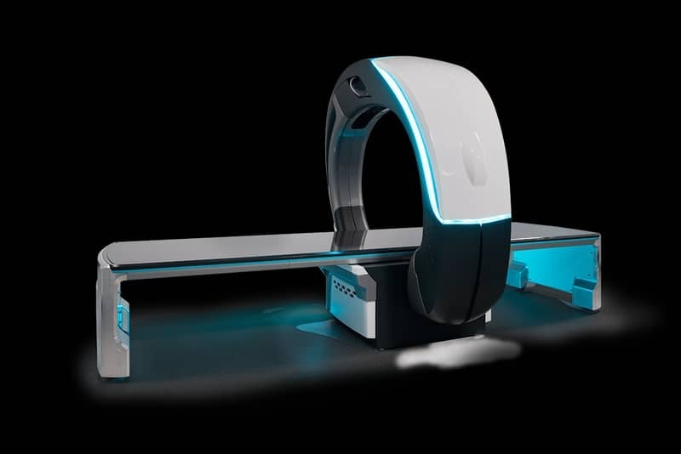
FUTURE
4. MRI Centre
The inspection of centers for the installation of the MRI machines by our foreign partners have been done.
The partners intend to bring in ultimately a total of 100 MRI machines, to be placed in hospitals all over the nation.

Slide 133
FUTURE
5. Feeding Centres
We have established additional 10 feeding Centres in Ikorodu. This brings to 32 the number of daily feeding centres being operated by the mission.

Slide 134
FUTURE
6. Enoch & Folu Adeboye Dialysis Centre
We are setting up in the first quarter of 2022 the Enoch & Folu Adeboye Dialysis Centres at the following hospitals:
Asokoro General Hospital, Abuja.
Braithwaite Memorial Teaching Hospital, Port Harcourt, Rivers State.
University of Nigeria Teaching, Ituku-Ozalla, Enugu, Enugu State.
We plan to set up a total of 10 dialysis centres in 2022.

Slide 135
FUTURE
7. Youths
The youths are to be engaged in the frontline of CSR activities. Their areas of interest includes:
Social Justice – Fair treatment of all people in a society, including respect for the rights of minorities and equitable distribution of resources among members of a community.
Prison Reformation
Skills Acquisition

Slide 136
FUTURE
7. Youths
d. Entrepreneurships
e. AI & Robotics Training
f. Project Management
g. Sport & Entertainment
h. Targeted Ted-talks and Webinars

Slide 137
FUTURE
8. FARM SETTLEMENT
As a corollary to our feeding initiatives, the mission has commenced a backward integration to owning of farm settlements by Provinces and Regions all over the country.

Slide 138
FUTURE
8. FARM SETTLEMENT
To this effect, every province/region is to avail the office of the Intercontinental Overseer CSR with the details of their farm settlement programs, acquired farmlands, type of agriculture to be engaged upon etc.

Slide 139
FUTURE
8. FARM SETTLEMENT
The objective is to begin to grow food that will assist our members in the fight against hunger and provide economic activities including employment for those involved.

Slide 140
Conclusion
It is clear that CSR is a strategic tool relevant for the advancement for the kingdom of God here on earth.
As a mission, we have layed our hands on the plough, and there is know going back.

